Slide 1
PRME Chapter UK & Ireland
Preparing your 2025 SIP Report
Tuesday 8 April 2025
Dr Laura Steele (laura.steele@qub.ac.uk) Queen’s Business School, PRME UK & Ireland Chapter Vice-Chair

Slide 2
Welcome & Overview
Background & Context
SIP Policy & SIP Resources
The PRME Commons
Primary Changes from 2024
Key Terminology & Types of Evidence
Content of the 2025 SIP Report
FAQs
What Next?
Agenda

Slide 3

Background & Context
It was widely acknowledged that the SIP reporting process required reform to be fit for purpose in an increasingly complex, fast paced, and data-driven world.
As a result, the PRME SIP Impact Sub-Committee was formed in 2020. They developed a new SIP reporting ‘logic’, which was subject to extensive consultation (including in UK & I in 2022).
A pilot took place in 2023, with the new SIP reporting process (referred to as “SIP 2.0”) formally launched in 2024.
The UK & I held several workshops to help Signatories prepare for SIP 2.0 and provided extensive feedback to the Secretariat.
There are further refinements to the SIP process, content, and submission platform (the PRME Commons) for 2025…

Slide 4
SIP Policy
The SIP reporting period opened on 31 March 2025 and will close on 30 September 2025.
The 2025 SIP should cover the 2024 calendar year (BUT it is understood that this may cause issues for some institutions who to do their reporting on an academic year basis–see the SIP FAQs).
Signatories must answer all the questions, upload all the objects, and complete all the narratives required for each Principle to have a complete submission. Not all question responses will require object uploads or narratives.
New joiners do not need to submit a SIP until the year after joining. For example, Signatories joining PRME in 2025 do not need to submit a SIP until 2026.
Signatories, excluding new joiners, who fail to submit a SIP within the submission period will be listed as ‘Non-communicating’ on their Signatory profile.
‘Non-communicating’ Signatories who do not submit a late SIP by 31 December 2025 will be ‘Delisted’ from PRME in 2026.
You can read the full PRME SIP Policy here.

Slide 5
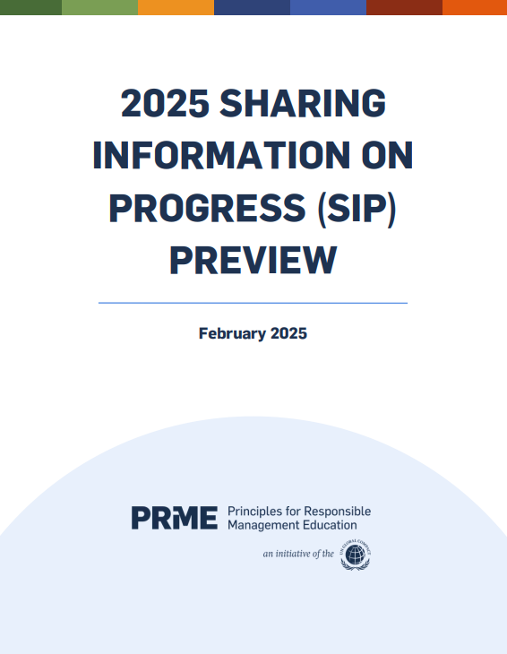
SIP Resources
There are helpful resources available to support the development of your SIP:
The ‘SIP Preview’ is available in both PDF and Excel format here.
In addition, the following videos are available on YouTube:
2025 SIP Informational Webinar
SIP Submission Kick-off & Step-by-Step Guide
PRME Commons: An Introduction to Evidence
To keep up-to-date about PRME Global SIP events, make sure to sign up to the newsletter here.

Slide 6







Commons
A comprehensive digital platform to support PRME’s work in
CREATING
ORGANIZING
SHARING
Responsible Management Education content and SIP reporting to foster
If you cannot access the PRME Commons, email commons@unprme.org
COLLABORATION
COMMUNICATION
RECOGNITION
within the global RME community.

Slide 7
The Commons
PROGRESS
Layer 3
PRME SIP dashboard with unique institutional profile
INFORMATION
Library of educational & pedagogical materials
Layer 2
PRME Resource Sharing Community
Peer to peer learning with continuous content improvement
SHARING
Layer 1
PRME self-reporting tool (SIP 2.0) and repository

Slide 8
Primary Changes from 2024
According to the PRME Secretariat, key changes for 2025 include:
Simplification of evidence in SIP reports (“objects” and “narratives” are now “evidence”).
The introduction of “prompts”. Questions are closed-ended and do not require evidence to answer (e.g., multiple-choice or short answer responses). In contrast, prompts require a response in the form of evidence (e.g., an attachment, narrative, image, course, research project, award).
Demonstrating progress and reflection. Questions and prompts are organised into two distinct categories under each Principle: Progress and Reflection. All questions and prompts under the Reflection tab will be optional in 2025.
A new ‘Getting Started’ section. This includes foundational information about the Signatory, including key details and basic institutional data.
New Profile Types, User Flows, and User Roles.
Later in the year, the Secretariat have advised that new design functionality will be added allowing for the creation of more polished, visually appealing reports.

Slide 9
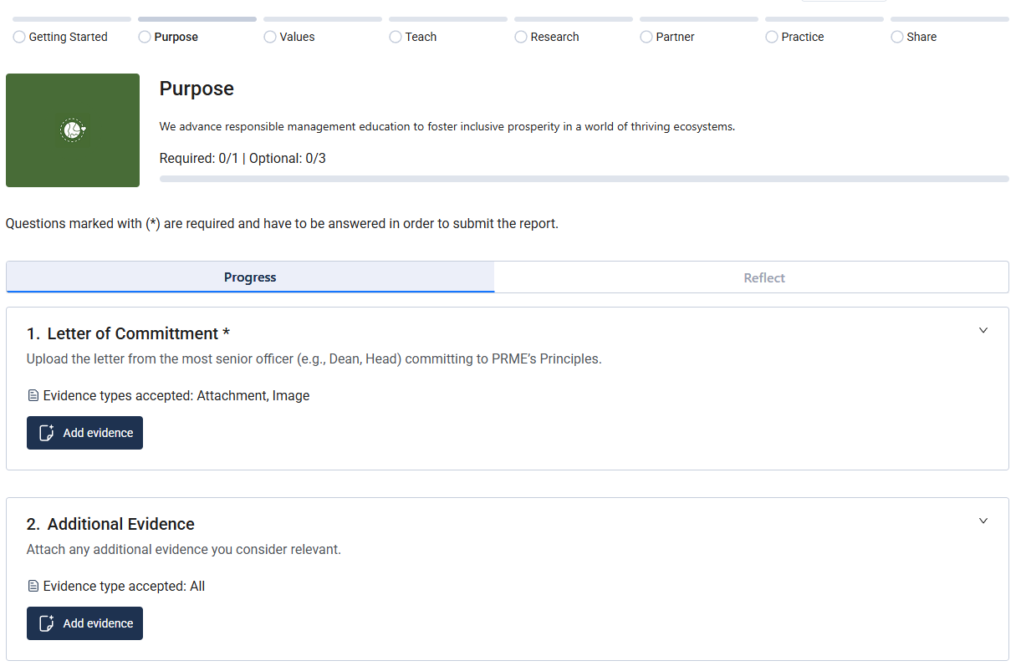
Primary Changes from 2024
Progress & Reflect

Slide 10
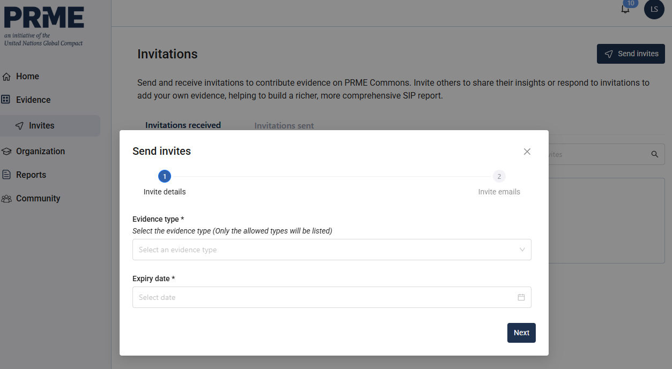
Primary Changes from 2024
Invites to Contribute

Slide 11
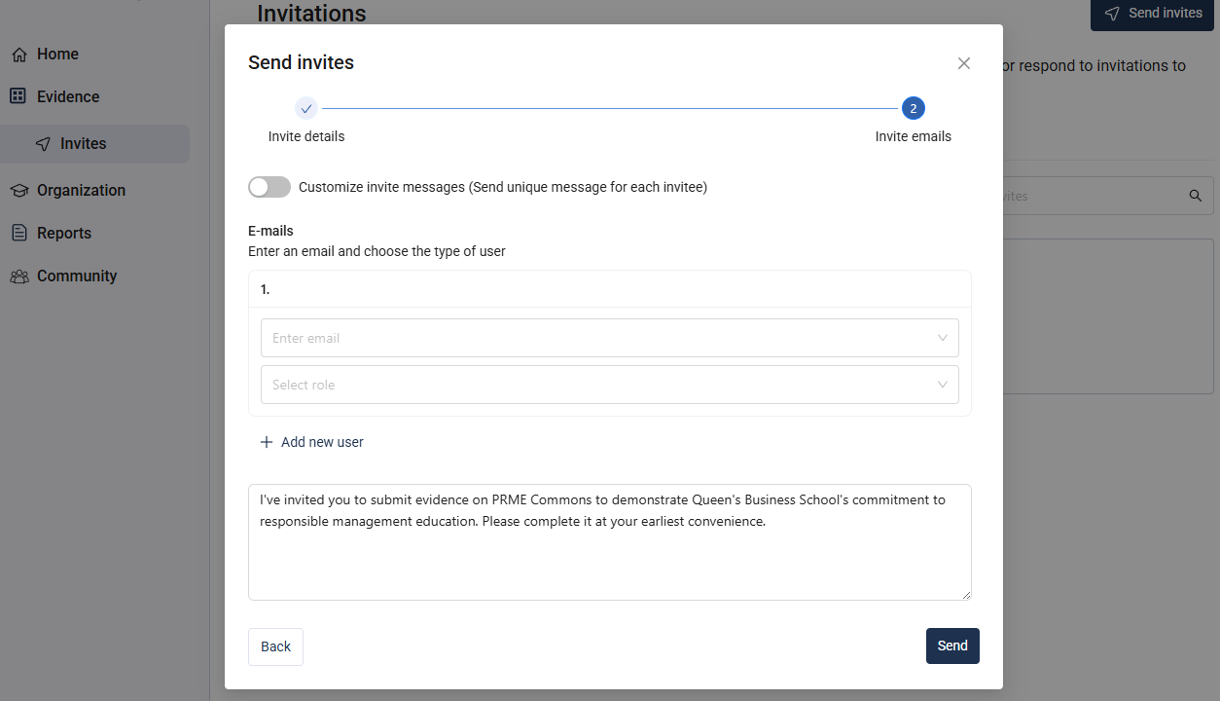
Primary Changes from 2024
Invites to Contribute

Slide 12
Key Terminology
Type of Term | Term | Definition
SIP Related | Your Institution/ PRME Signatory | The unit or institution that is governed by the individual who signed the membership to PRME.
 | Question | A request for information required to be answered as part of the SIP reporting process. These questions do not require evidence to be marked as complete.
 | Prompt | A request for information required to be answered as part of the SIP reporting process. These prompts do require evidence attached to them to be marked as complete. Signatories can add prompts to further demonstrate their impact.
 | Evidence | Information attached to a prompt to provide additional context and support the Signatories demonstration of progress. There are nine different types of evidence that create a repository within the PRME Commons.
 | Progress | A compilation of questions and prompts that demonstrate a Signatory’s progress in implementing the Principles. Some are mandatory and others can be added by Signatories to further demonstrate progress.
 | Reflection | A compilation of questions and prompts that encourage the Signatory to reflect on their progress in implementing the Principles. These are all optional and additional prompts can be added by Signatories to further highlight reflections.
Source: PRME SIP Preview 2025

Slide 13
Type of Term | Term | Definition
PRME Commons | Evidence Repository | Where users can access their evidence, the evidence of their institution, or evidence from other members of the community.
 | Institutional Account | The collection of users all tied to a Signatory Member within PRME Commons
 | Admin | The individual responsible for managing and overseeing the institutional account on PRME Commons. Only this individual can submit the SIP report.
 | Supervisor | The individual responsible for managing and overseeing the SIP report.
 | Contributor | An individual, who supports the publishing of the SIP report and can contribute content for specific sections of the SIP report.
 | Member | An individual who cannot contribute to the SIP report, but can access the Community Page.
 | Non-Signatory Contributor | An individual who can fill out evidence in support of the SIP report but cannot view or interact with any other aspects of PRME Commons. This user type is for contributions from individuals outside of the Signatory Member.
Sharing rights (Who can access the information) | Public | Data selected as public can be used to share with third parties and global communications.
 | Private | Data selected as private will only be available for your institution.
 | PRME Community | Data selected will be shared with the PRME Secretariat and Signatory Members.

Slide 14
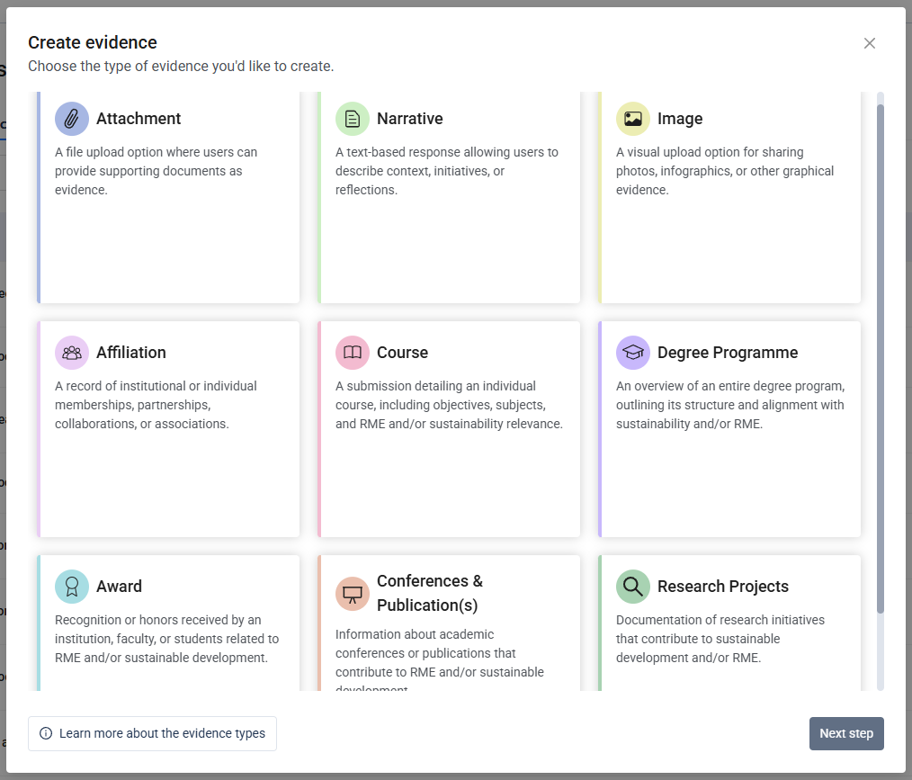
Types of Evidence
Click the information icon for more guidance on and examples of each type of evidence.

Slide 15
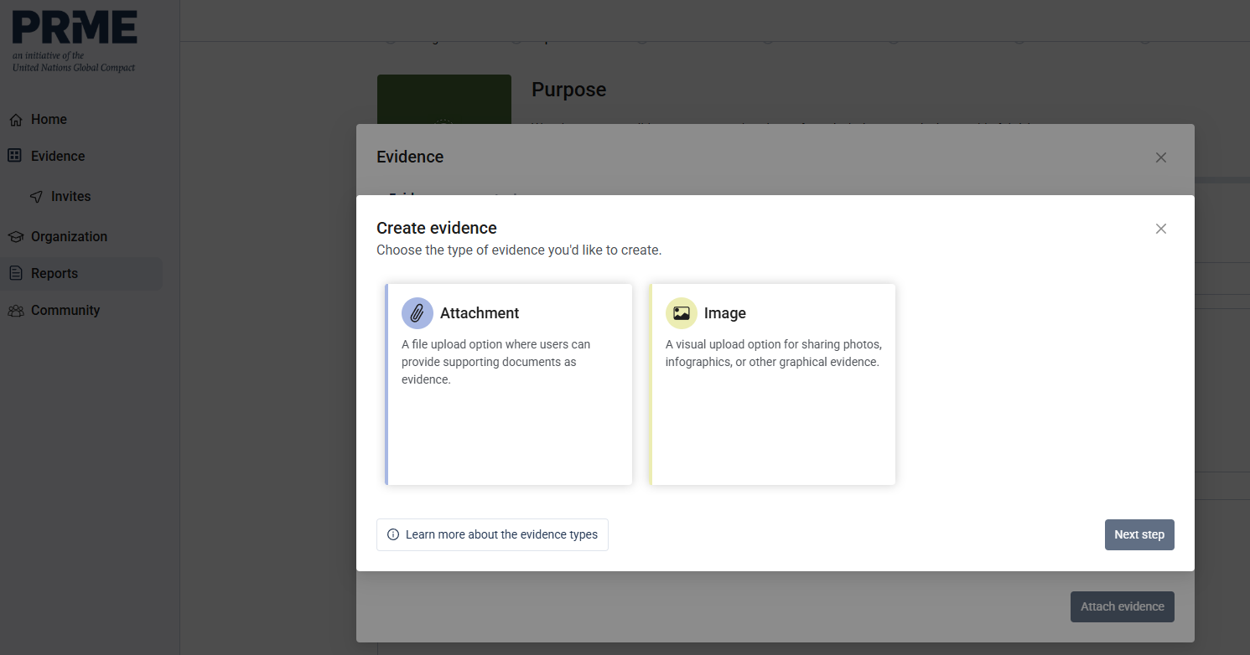
Types of Evidence
When in your report, if you select “Add Evidence” it will automatically direct you to the accepted forms of evidence for that specific prompt.

Slide 16








Content of the 2025 SIP
GETTING STARTED
Mandatory: Questions: 2 | Prompts: 4
Optional: Questions 8 | Prompts 5
RESEARCH
Mandatory: Questions: 4 | Prompts: 0
Optional: Questions 2 | Prompts 5
PURPOSE
Mandatory: Questions: 0 | Prompts: 1
Optional: Questions: 2 | Prompts 0
PARTNER
Mandatory: Questions: 2 | Prompts: 0
Optional: Questions: 1 | Prompts 2
VALUES
Mandatory: Questions: 1 | Prompts: 0
Optional: Questions: 3 | Prompts 3
PRACTICE
Mandatory: Questions: 1 | Prompts: 0
Optional: Questions: 1 | Prompts: 3
TEACH
Mandatory: Questions: 0 | Prompts: 1
Optional: Questions: 8 | Prompts 2
SHARE
Mandatory: Questions 2 | Prompts: 0
Optional: Questions 2 | Prompts 1
NOTE: Evidence requirements may change based on your question responses
Notes:
Getting Started: Foundational information about your institution that typically require minimal updates year to year.
Purpose: Commitment, Strategic Alignment, Involvement in PRME.
Values: Policies, Practices, Diversity, Equity, & Inclusion, Student Engagement.
Teach: Courses, Recognition, Curricula, Pedagogy.
Research: Publications, Projects, Funding, Awards.
Partner: Stakeholders, Collaborations, Business Sector, Accreditation Bodies.
Practice: Facilities, Transportation, Personnel.
Share: Engagement, Audiences, Communications.

Slide 17
Getting Started
Mandatory Prompts & Questions
Type | Requirement | Prompt/Question | Evidence
Prompt | Mandatory | Instititional Mission | Narrative
Prompt | Mandatory | Institutional Vision | Narrative
Prompt | Mandatory | Instititional Strategy | Narrative, Attachment
Prompt | Mandatory | Institutional Strategy Alignment | Narrative
Question | Mandatory | Number of Graduates Annually | N/A
Question | Mandatory | Degrees Offered (e.g., BA, BSc, MSc). | N/A
Notes:
Getting Started
This section provides foundational information about your organization, including key details and basic institutional data. These elements serve as a starting point for your SIP report, can be copied annually, and typically require minimal updates from year to year.

Slide 18
Getting Started: Optional Prompts & Questions
Type | Requirement | Prompt/Question | Evidence
Question | Optional | Number of Faculty & Staff at the Parent University | N/A
Question | Optional | Number of Faculty & Staff at the Institution (e.g., the B-School) | N/A
Question | Optional | Number of Students at the Parent University | N/A
Question | Optional | Number of Students at the Institution | N/A
Question | Optional | Number of UG Students at the Institution | N/A
Question | Optional | Number of PG Students at the Institution | N/A
Question | Optional | Number of Doctoral Students at the Institution | N/A
Question | Optional | Number of certificate, professional development, or continuing education students at the institution | N/A
Prompt | Optional | Undergraduate Degree Programmes | Degree Programme
Prompt | Optional | Masters Degree Programmes | Degree Programme
Prompt | Optional | Postgraduate (Doctoral) Degree Programmes | Degree Programme
Prompt | Optional | Certificates, Professional Development, or Associate Programmes | Degree Programme
Prompt | Optional | Institutional History | Narrative

Slide 19
Purpose
Progress & Reflect – Mandatory & Optional
Progress
Type | Requirement | Prompt/Question | Evidence
Prompt | Mandatory | Letter of Commitment | Attachment, Image
Reflect (Optional for 2025)
Question | Optional | Define Purpose: Read the definition of the Purpose Principle. How do you define Purpose in this context and in your institution? (50 words max) | N/A
Question | Optional | Instititional Engagement: What percentage of faculty at your institution actively contribute to your work with PRME, advancing RME, or addressing sustainable development challenges through their work? (0-25%, 26-50%, 51-75%, or 76-100%) | N/A
Notes:
Purpose
We advance responsible management education to foster inclusive prosperity in a world of thriving ecosystems.

Slide 20
Values
Progress – Mandatory & Optional
Progress
Type | Requirement | Prompt/Question | Evidence
Question | Mandatory | PRME Lead (Multiple options to describe how PRME/ RME is approached within the School) | N/A
Prompt | Optional | Option to share “Student Voices” | Narrative
Prompt | Optional | Option to “Celebrate Values” | Narrative
Prompt | Optional | Option to share “Values Voices” | Narrative
Notes:
Values
We place organizational responsibility and accountability to society and the planet at the core of what we do.
Student Voices: Invite students at your institution to share narratives that showcase how RME has influenced their academic journey and personal growth.
Celebrating Values: Share, or invite members of your institution to share, ways in which your institution celebrates values, such as specialization in ethics, spirituality, religion, diversity, and/or inclusion.
Values Voices: Invite any other members of your institution and/or your institution's values-oriented community that you would like to contribute narratives to the Values Principles in this SIP report.

Slide 21
Values
Reflect - Optional
Reflect (Optional for 2025)
Type | Requirement | Prompt/Question | Evidence
Question | Optional | Define Values: Read the definition of the Values Principle. How do you define Values in this context and in your institution? (50 words max) | N/A
Question | Optional | Student Awareness: What percentage of students at your institution are aware that it is a PRME Signatory? Consider if it is shared at new student orientations, in courses, in promotional materials for the institution, etc. (0-25%, 26-50%, 51-75%, or 76-100%) | N/A
Question | Optional | Student Engagement: What percentage of students at your institution actively contribute to your work with PRME, advancing RME, or addressing sustainable development challenges through their work? (0-25%, 26-50%, 51-75%, or 76-100%) | N/A

Slide 22
Teach
Progress – Mandatory & Optional
Progress
Type | Requirement | Prompt/Question | Evidence
Prompt | Mandatory | Share examples of Courses (a.k.a. “modules”). | Course
Prompt | Optional | Option to share relevant Teaching Awards | Award
Prompt | Optional | Option to share “Teaching Voices” | Narrative
Question | Optional | Fostering Innovation: Teaching and learning at your institution fosters innovation. (Not at all, Somewhat, A lot, To a great extent). | N/A
Question | Optional | Experiential Learning: Teaching and learning at your institution encourages experiential learning. (Not at all, Somewhat, A lot, To a great extent). | N/A
Question | Optional | Learning Mindset: Teaching and learning at your institution promotes a lifelong learning mindset. (Not at all, Somewhat, A lot, To a great extent). | N/A
Question | Optional | Method of Teaching and Learning (In person, Virtual, Hybrid). | N/A
Notes:
Teach
We transform our learning environments by integrating responsible management concepts and practices into our curriculum and pedagogy.
Courses: Share your, and/or invite educators at your institution to share their courses. We encourage at least one from each of the following disciplines: Business Administration, Accounting, Business Analytics, Computer Information Systems, Economics, Entrepreneurship, Finance, Human Resource Management, International Business, Management, and Marketing.
Teaching Awards: Share, and/or invite educators to share, any awards received by your institution or by members of your institution for responsibility- and/or sustainability-related teaching and/or pedagogy.
Teaching Voices: Invite any other educators from your institution's teaching and learning offices to share their innovative approaches, course designs, and teaching strategies that align with sustainable development and/or responsibility. These narratives will serve as exemplars of how your institution is preparing students to meet global challenges.

Slide 23
Teach
Reflect - Optional Questions
Reflect (Optional for 2025)
Type | Requirement | Prompt/Question | Evidence
Question | Optional | Define Teach: Read the definition of the Teach Principle. How do you define Teach in this context and in your institution? (50 words max) | N/A
Question | Optional | Educator Recognition: In what ways are educators awarded for quality of teaching at your institution? (Multiple options to select from) | N/A
Question | Optional | Barriers to Innovative Curriculum: What are the barriers to innovating, updating, or taking risks in existing curriculum? (Multiple options to select from) | N/A
Question | Optional | Barriers to Innovative Pedagogy: What are the barriers to innovating, updating, or taking risks in existing pedagogy? (Multiple options to select from) | N/A

Slide 24
Research
Progress – Mandatory & Optional
Progress
Type | Requirement | Prompt/Question | Evidence
Question | Mandatory | Number of peer reviewed academic publications | N/A
Question | Mandatory | Number of peer reviewed academic publications on Sustainable Development and/or RME | N/A
Question | Mandatory | Research Funding (Multiple options to select where research funding comes from, e.g., local, regional, national, international) | N/A
Question | Mandatory | Socializing Research (Multiple options to select how research is disseminated) | N/A
Prompt | Optional | Option to share information on relevant Research Projects | Research Projects
Prompt | Optional | Option to share information on relevant Research Awards | Award
Prompt | Optional | Option to share information on relevant Research Presentations | Conferences & Publications
Prompt | Optional | Option to share research publications from the last year | Conferences & Publications
Prompt | Optional | Option to share “Research Voices” | Narrative
Notes:
Research
We study people, organizations, institutions, and the state of the world to inspire responsible management and education practice.
Research Projects: Share, and/or invite members from your institution to share, research projects from the past year that have implemented responsible or sustainable activities.
Research Awards: Share, and/or invite members of your institution to share, any awards received by individuals or by your institution for responsibility- and/or sustainability-related research.
Research Presentations: Invite members from your institution to share research presentations and their outcomes related to RME and/or sustainable development given at conferences.
Research Voices: Invite any other members of your community that you would like to contribute narratives to the Research Principle in this SIP report. This could include research-partners; campus think-tanks; civil society partners; etc.

Slide 25
Research
Reflect - Optional Questions
Reflect (Optional for 2025)
Type | Requirement | Prompt/Question | Evidence
Question | Optional | Define Research: Read the definition of the Research Principle. How do you define Research in this context and in your institution? (50 words max) | N/A
Question | Optional | Research Barriers: What are the biggest barriers to conducting research related to sustainability and/or responsibility? (Multiple options to select from) | N/A

Slide 26
Partner
Progress – Mandatory
Progress
Type | Requirement | Prompt/Question | Evidence
Question | Mandatory | Provide details of Partners, Accreditation Bodies, Associations, etc. (e.g. AACSB, AMBA, EFMD, Sulitest) Note: when an option is selected, the following question appears: ‘This affiliation, partnership, collaboration, and/or association moves my progress in advancing sustainable development and/or responsibility: Not at all, Somewhat, A lot, To a great extent. | N/A
Question | Mandatory | Provide details of Student Partners (e.g., Enactus, oikos International, PRME Global Students) Note: when an option is selected, the following question appears: This affiliation, partnership, collaboration, and/or association moves my progress in advancing sustainable development and/or responsibility: Not at all, Somewhat, A lot, To a great extent. | N/A
Notes:
Partner
We engage people from business, government, civil society, and academia to advance responsible and accountable management education and practice.

Slide 27
Partner
Progress and Reflect – Optional
Progress
Type | Requirement | Prompt/Question | Evidence
Prompt | Optional | Option to share more information about institutional partners, inc. those identified in the previous question | Affiliations
Prompt | Optional | Option to share “Partner Voices” | Narrative
Reflect (Optional for 2025)
Question | Optional | Define Partner: Read the definition of the Partner Principle. How do you define Partner in this context and in your institution? (50 words max) | N/A
Notes:
Partners: Share, and/or invite members from your institution to share your institution's affiliations with other key stakeholders, such as organizations, student groups, non-profits, government, etc., that have helped your institution advance sustainability and/or responsibility. If you selected any organizations in the questions above, we highly encourage you to share more about your work with them.
Partner Voices: Invite any partners that you would like to contribute narratives to the Partner Principle of this SIP report.

Slide 28
Practice
Progress and Reflect – Mandatory & Optional
Progress
Type | Requirement | Prompt/Question | Evidence
Question | Mandatory | RME Practices: Share institutional (university and/or business school) policies related to sustainability and responsibility) | N/A
Prompt | Optional | RME Policies (share relevant policies, e.g., carbon reduction plan, sustainable travel plan, responsible procurement policy, via upload) | Attachment
Prompt | Optional | Opportunity to share “Practice Awards” | Award
Prompt | Optional | Opportunity to share “Practice Voices” | Narrative
Reflect (Optional for 2025)
Question | Optional | Define Practice: Read the definition of the Practice Principle. How do you define Practice in this context and in your institution? (50 words max) | N/A
Notes:
Practice
We adopt responsible and accountable management principles in our own governance and operations.
RME Practices: Has your institution or its governing parent institution adopted policies that are intended to influence how faculty, staff and students support its commitment to sustainability and/or responsibility? (A single policy may meet multiple criteria, so please select all that apply.)
RME Policies: Share policies set by your institution or your parent institution that are intended to influence how faculty, staff and students support its commitment to sustainability and/or responsibility.
Practice Awards: Share, and/or invite members of your institution to share, any awards received by your institution or by individuals in your institution for responsible and/or sustainable practices.
Practice Voices: Invite any other internal stakeholders to share narratives that contribute to the Practice Principle in this SIP report. This could include the VP of Operations; groundskeepers; staff at energy services; etc.

Slide 29
Share
Progress and Reflect – Mandatory & Optional
Progress
Type | Requirement | Prompt/Question | Evidence
Question | Mandatory | Transparent Engagement: “In what ways does your institution offer transparent engagement opportunities for members of your institution and community to contribute to your sustainability and responsibility efforts?” (Multiple options to select) | N/A
Question | Mandatory | Audiences: “With whom does your institution communicate its policies and progress on sustainable development and responsibility?”. (Multiple options to select) | N/A
Prompt | Optional | Opportunity to share “Sharing Voices” | Narrative
Reflect (Optional for 2025)
Question | Optional | Define Share: Read the definition of the Share Principle. How do you define Share in this context and in your institution? (50 words max) | N/A
Question | Optional | Transparency Barriers: “What barriers does your institution face in transparent communications?”. (Multiple options to select) | N/A
Notes:
Share
We adopt responsible and accountable management principles in our own governance and operations.

Slide 30
FAQs
A lengthy list of FAQs is available on the PRME website here. Some very common questions include:
Can I request an extension for my institution's SIP? No. From 30 September 2025 the Signatory will be listed as “Non-Communicating” if they have not submitted their SIP. However, they will not be delisted until January 2026.
What period should the SIP report cover? The PRME Commons is structured around the calendar year, but PRME recognize that many university documents and policies are written for the academic year or span multiple academic years. Therefore, they state: “Please answer each question in the way that best reflects your institution’s practices. Use your judgment to determine which documents most accurately represent your efforts during the suggested time period”. Please click here for the full answer to this question.
Can I invite other members of my institution to PRME Commons to support our SIP submission? Yes, this is encouraged! (Again, see the FAQ page for details of the different levels of permissions in the Commons – Admins, Supervisors, Contributors, and Members).
Can I save as I go on PRME Commons? Yes – but once you submit you cannot edit the SIP!

Slide 31
What does a “Good” SIP Look Like?
According to the PRME Chapter UK & Ireland Community:
Honest
Transparent
Open & Real
Impactful
Concise
Informative

Slide 32
What next?
The UK & Ireland Chapter will be hosting online drop-in sessions for ongoing support and discussion on the following dates:
📅 Thursday 8 May 2025, 10am to 11am (Register)
📅 Thursday 5 June 2025, 2pm to 3pm (Register)
📅 Thursday 3 July 2025, 10am to 11am (Register)
For further details and helpful resources, visit the PRME Chapter UK & Ireland website.
A group of PRME Champions led by Loughborough Business School and Queen’s Business School are currently undertaking a project analysing the content of 150+ SIP reports submitted in 2024. We look forward to sharing the results with the PRME Chapter UK & Ireland community later in 2025.
If you have any questions or suggestions, feel free to reach out to us at PRME@bcu.ac.uk.

