Slide 1
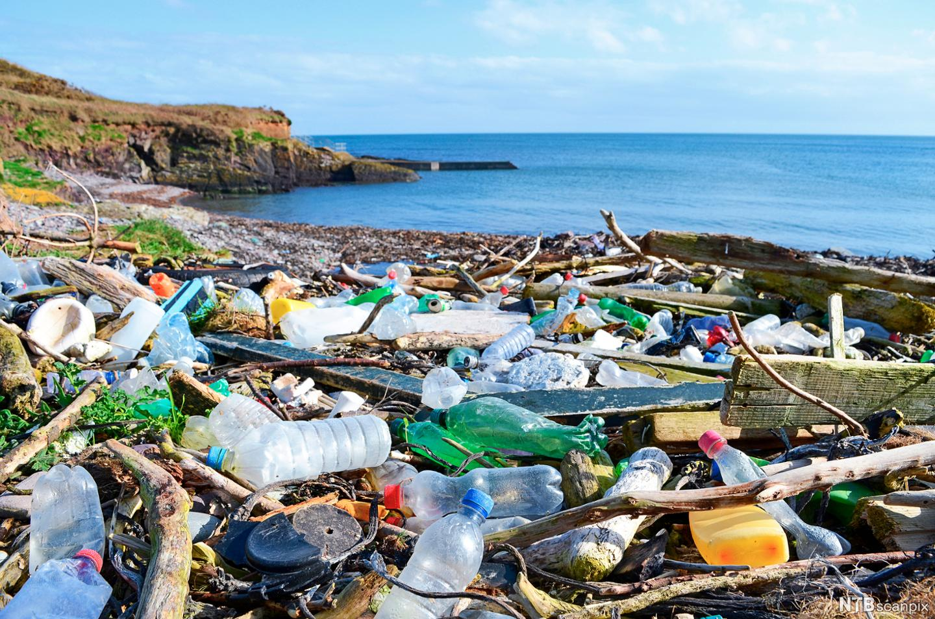



Marine Dumping on UK Coastlines
Raising sustainability awareness through a stakeholder-orientated experiential learning approach
Dr Pamela Yeow & Dr Neil Pyper (Birkbeck, University of London), Dr Krish Saha & Prof Vijay Reddy (Birmingham City University), and Chris Cornell (Kent County Council)

Slide 2
The Project
Aim and Outcomes
Context: Marine Dumping
Share our understanding about the use of scenario analysis and applied towards complex problem-solving challenges
Utilise a current issue with stakeholder input
Understand complexities of current environmental/sustainability issues
What is it?
Where is it taking place?
Who does it impact?
Who are the stakeholders?

Slide 3
Research Questions
RQ1: What is the current circular economy (CE) pedagogy for tertiary-level sustainability education?
RQ2: How can scenario analysis enhance/enrich circular economy (CE) pedagogy?
RQ3: How to embed scenario analysis approaches into the circular economy (CE) pedagogy?

Slide 4
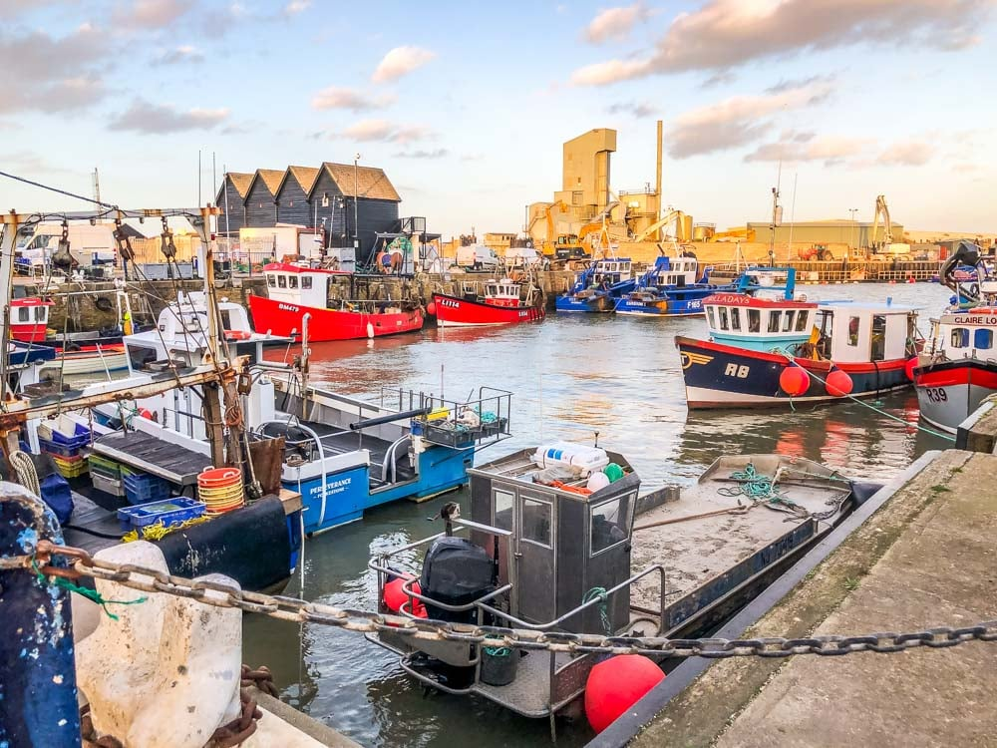
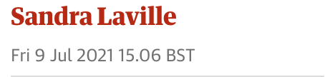

Slide 5
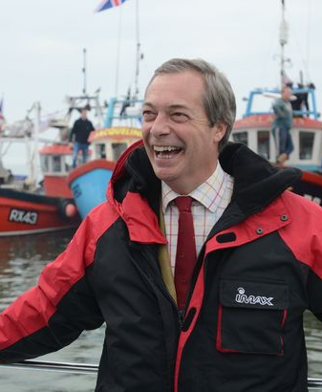
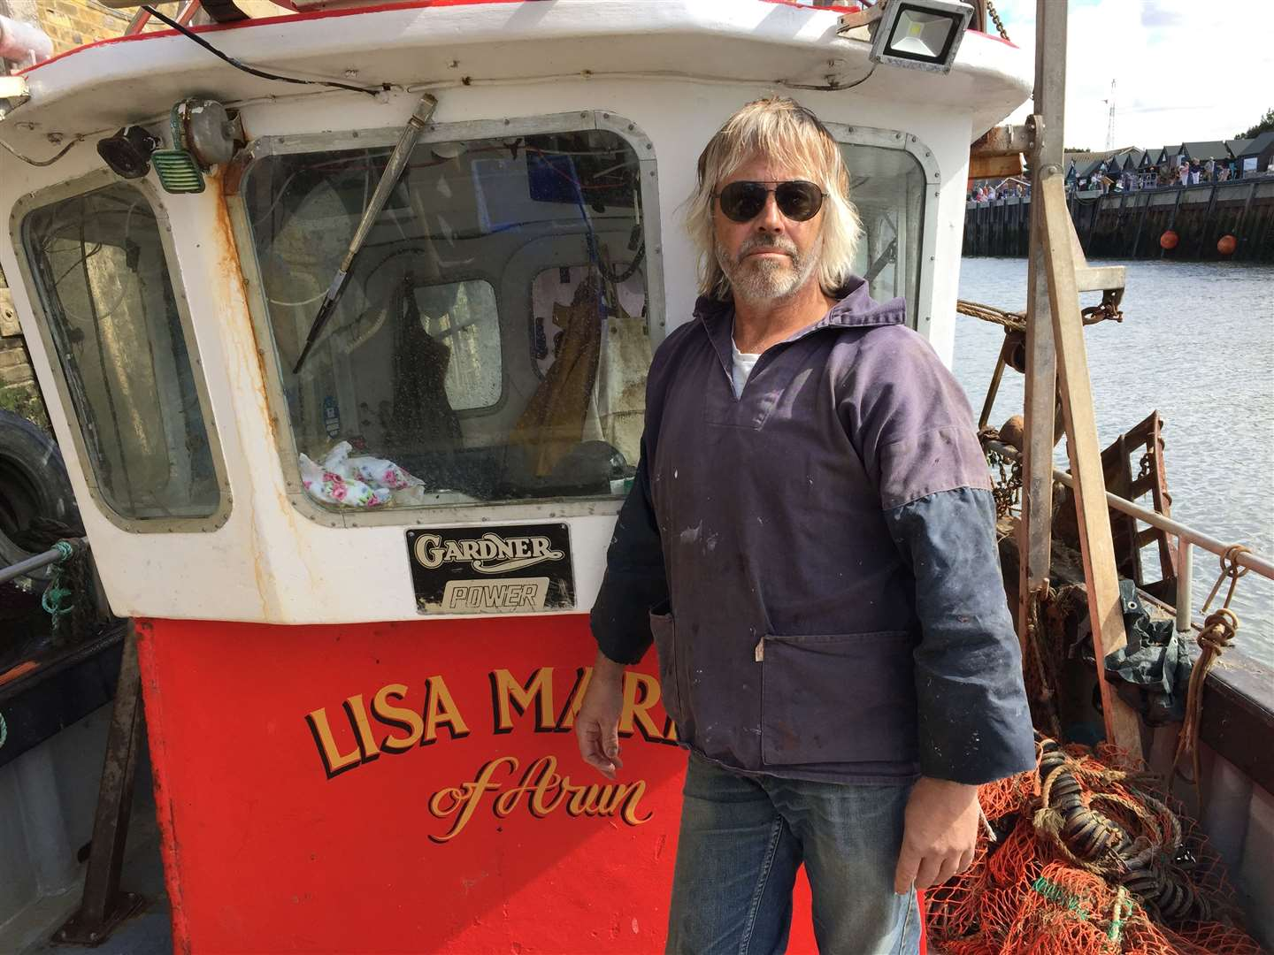
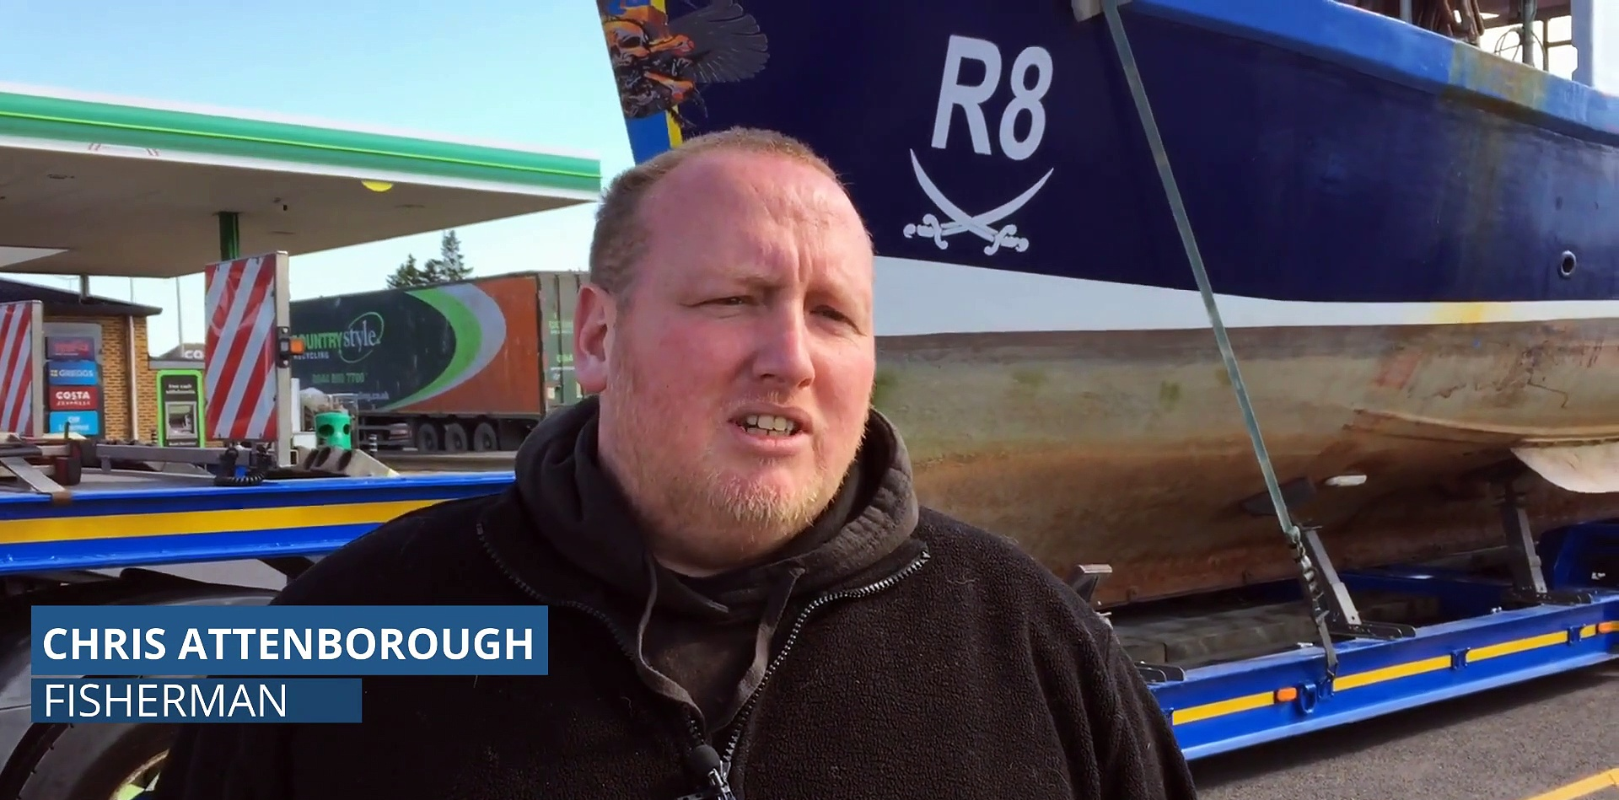

Slide 6
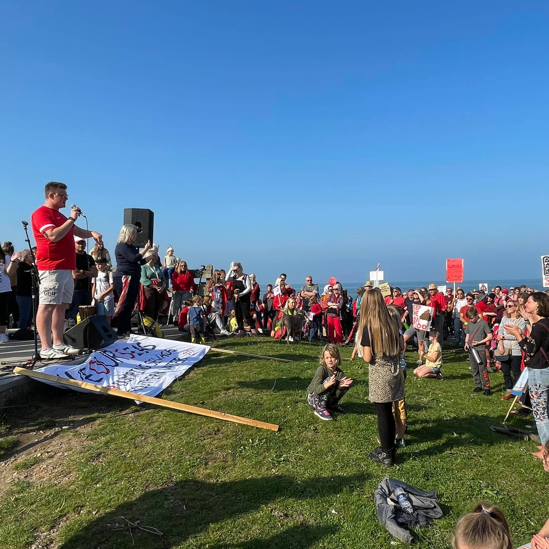
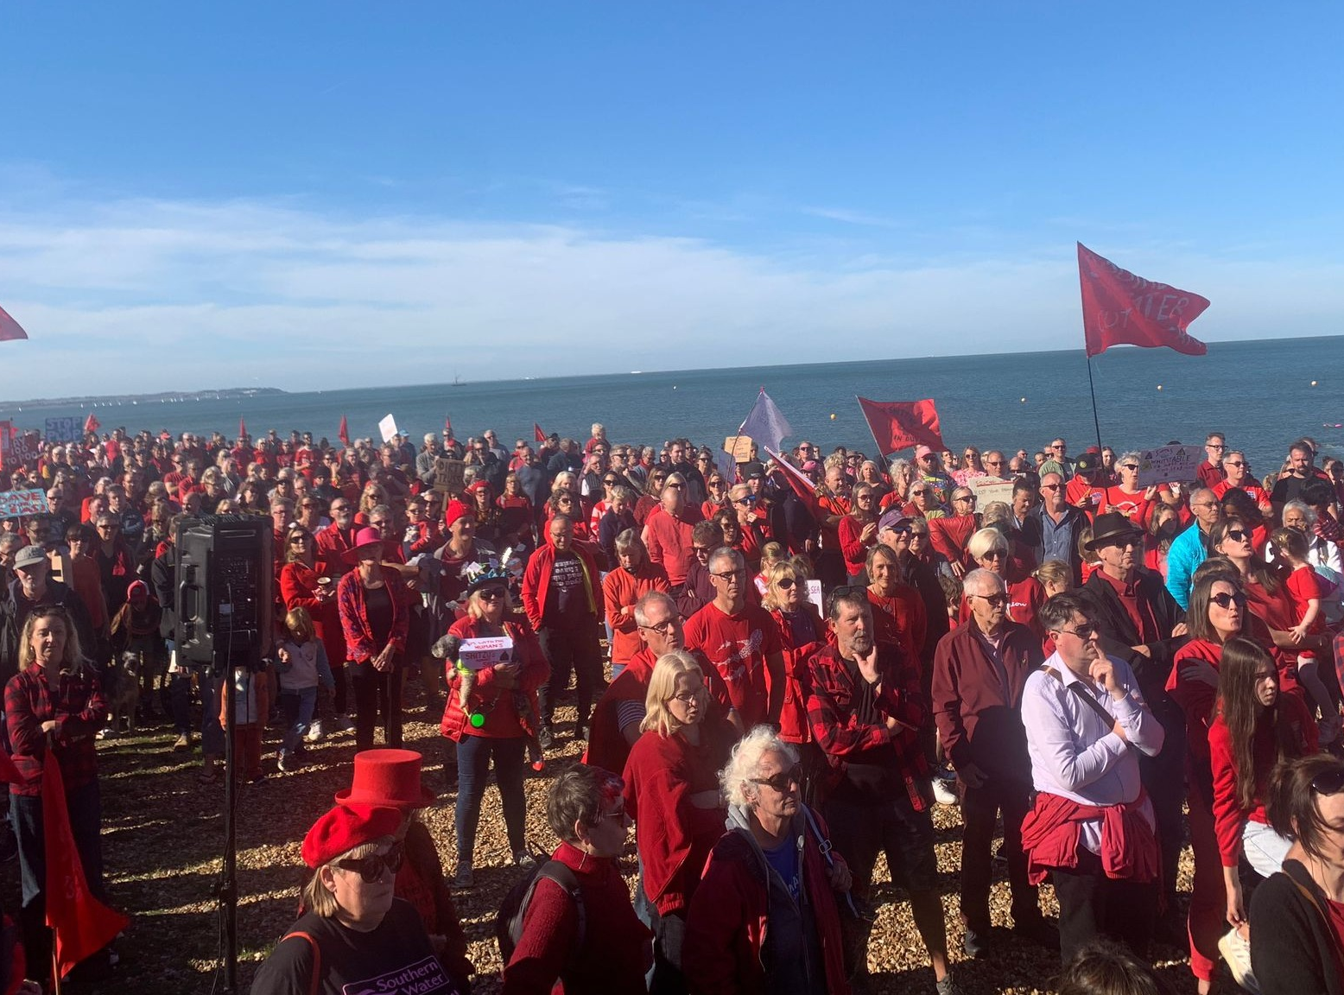
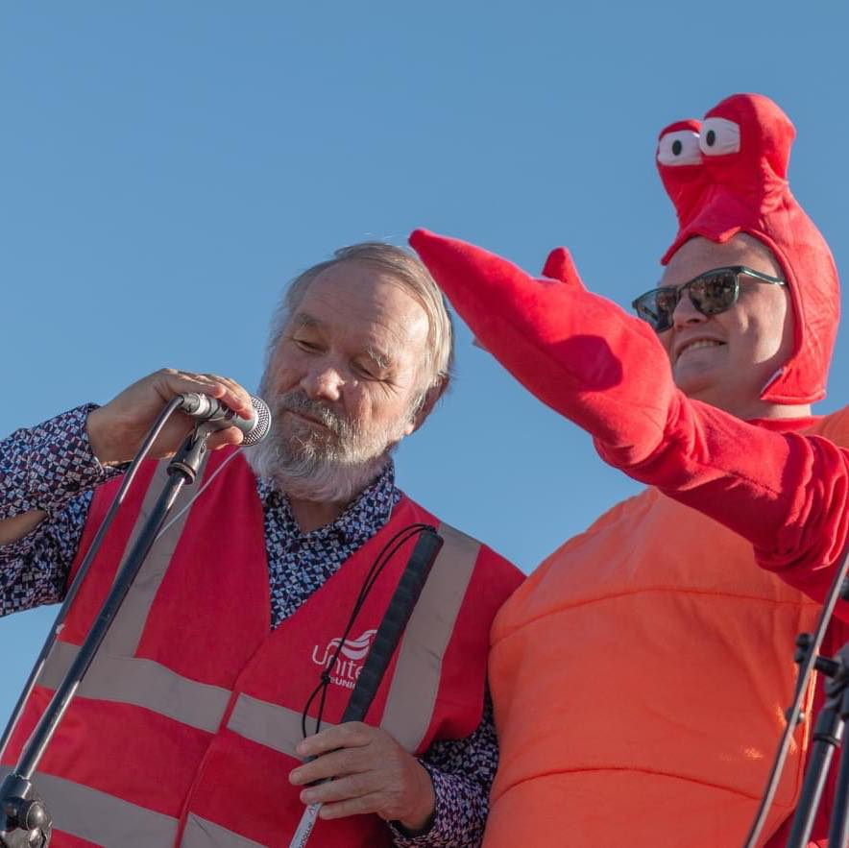

Slide 7
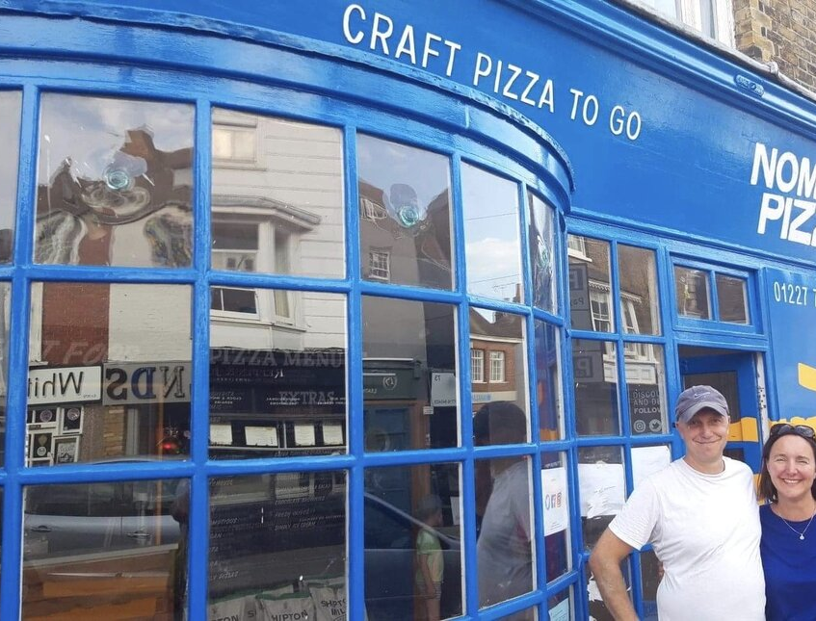
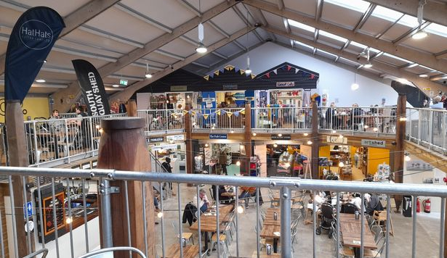
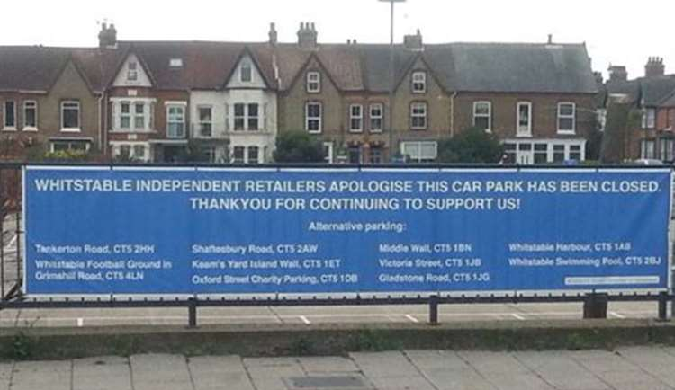
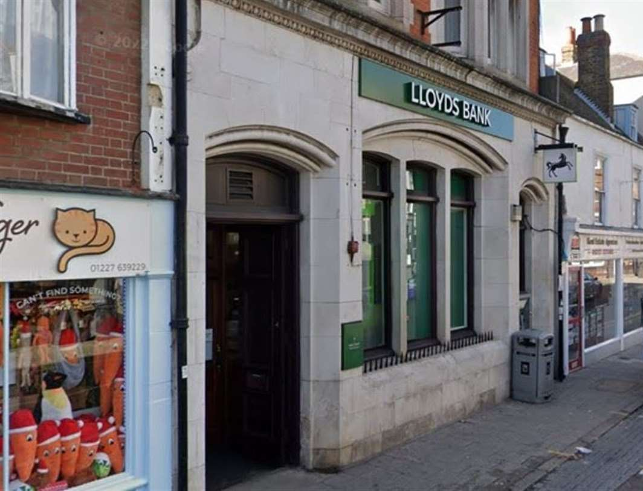

Slide 8
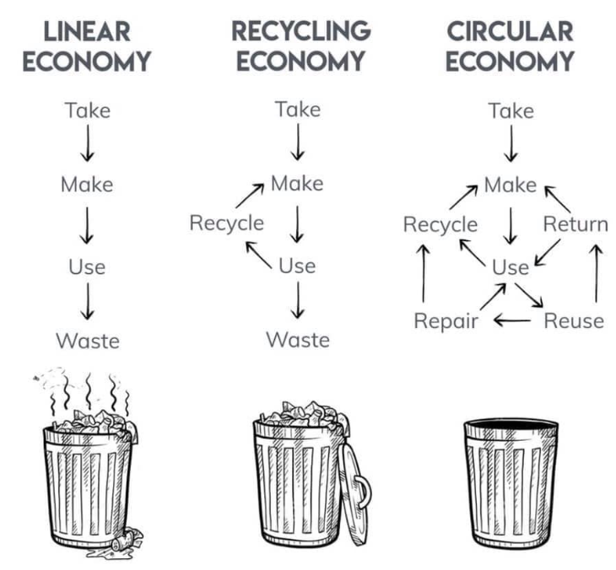
Context-Linear to Circular
A systems solution framework that tackles global challenges like climate change, biodiversity loss, waste, and pollution.
It is based on three principles, driven by design:
eliminate waste and pollution,
circulate products and materials (at their highest value), and
regenerate nature
Ellen MacArthur Foundation (2023)
Source: Chapman (2019).

Slide 9
Survey
We also did a survey to gather the voices of the local residents, industries (e.g. fisher people, café and shop owners, sea sport owners), and local councilors.
This was what we found…

Slide 10
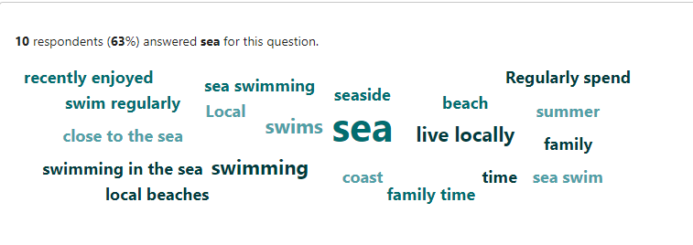
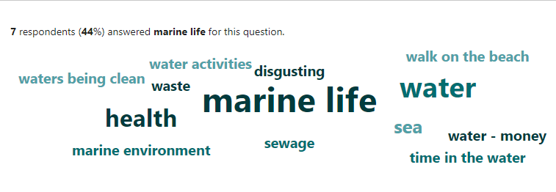
What do you do by the seaside?/Why are you concerned?

Slide 11
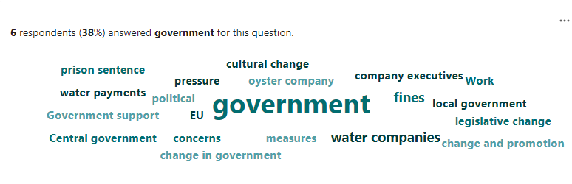
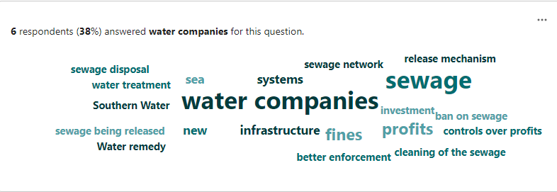
What solutions might there be?/How can we get there?

Slide 12
What did we do next?
Scenario analysis workshop

Slide 13
Aims of Scenario Analysis
To make sense of complexity and ambiguity in terms of possibility and plausibility
To think through alternative futures
To evaluate strategic options against these futures
To enhance the evaluation and integration of information
To encourage contingency planning for unfolding of both favorable and unfavorable futures
Not to predict ‘the future’, but to better understand the present

Slide 14
Workshop design
Initial presentation for context
Students worked on the scenarios by broadly following the steps set out in previous slide.
Used paper resources such as sticky notes and flipcharts (Wright and Goodwin, 2011; van der Heijden, 2004
Facilitators observed, supporting where necessary, but at the same time allowing participants to resolve problems themselves.
Ended with informal presentation of the scenarios, followed by discussion to explore the learning achieved, and reflection on how scenarios might be used.

Slide 15
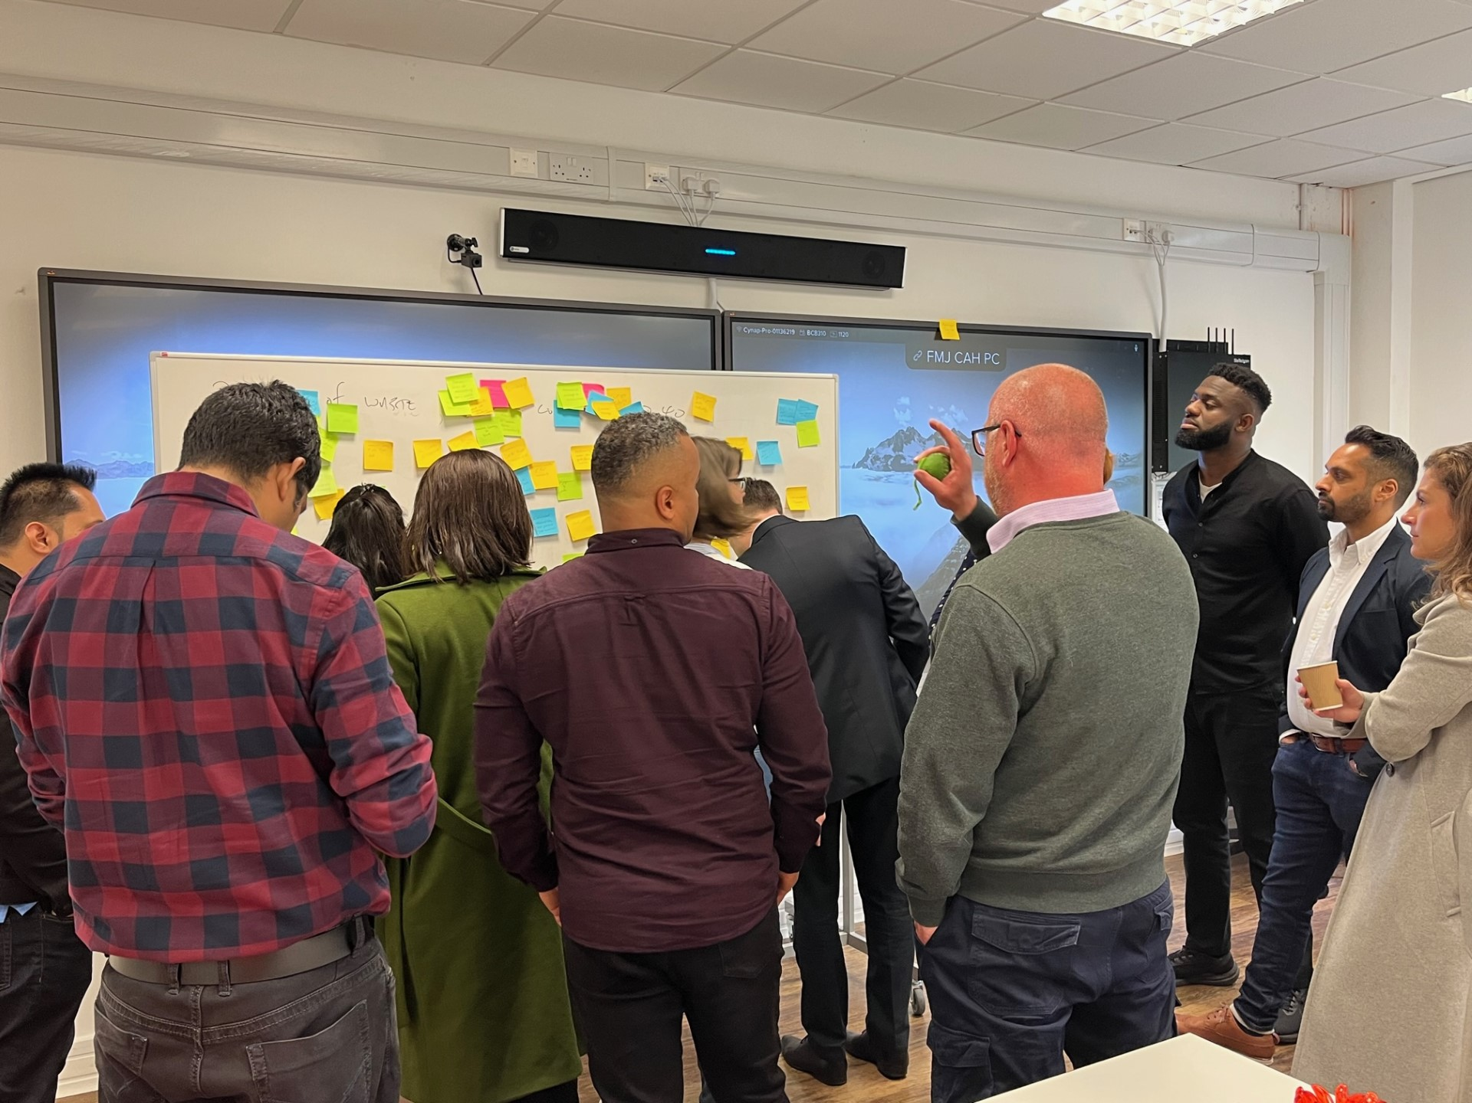
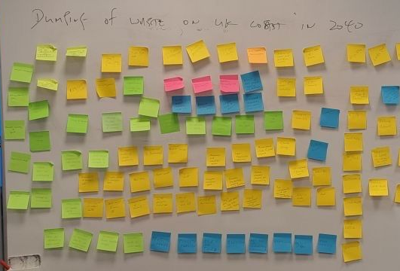
What did we find?

Slide 16
Economic salience
-
Low economic salience
Low awareness of climate impact
Low economic salience
High awareness of climate impact
Awareness of climate impact
-
+
High economic salience
Low awareness of climate impact
High economic salience
High awareness of climate impact
+

Slide 17
Scenario process
Setting the Agenda – defining the key focal issue of concern and outlining process
Determining the Driving Forces – working individually, then as a group
Clustering the Driving Forces – group discussion to develop, test and name the clusters
Defining the Cluster Outcomes – extreme outcomes for each of the clusters over the scenario period
Impact/Uncertainty Matrix – determining the scenario factors, A and B
Developing the Scenarios – working in sub-groups to develop scenario storylines
Framing the scenarios – defining the extreme outcomes of the key factors, A1/A2 and B1/B2
Scoping the scenarios – building the set of broad descriptors for 4 scenarios

