Slide 1



PRME & SDG Games:
Teaching Support Resources
Interactive learning tools for exploring sustainability and responsible management in the classroom.
Developed by:
David Anderson, University of Lincoln
Davina Bird, University of Lincoln
Date created: 2024-2025

Slide 2
Acknowledgment
Funded by: PRME UK & Ireland Seed funding Competition for Innovative Pedagogic Approaches and Teaching Practices in PRME.
Successfully applied for £750.
Project title: Learning the principles of responsible management through customised card games.
Call usually due mid December:
  https://www.unprme.org.uk/2024-developing-pedagogy-comp

Slide 3
Contents
Project Aim (Inputs), The Games & The Education Pack (Outputs)
Guidelines for implementing project resources into your classroom.
PRME & SDG Briefing Slides
Background information on Principles of Responsible Management Education (PRME) and Sustainable Development Goals (SDGs).
Games Details
Purpose, rules, and activities for the four games.
Additional Support
Where to find help for implementation.
Aim and games of the project.

Slide 4
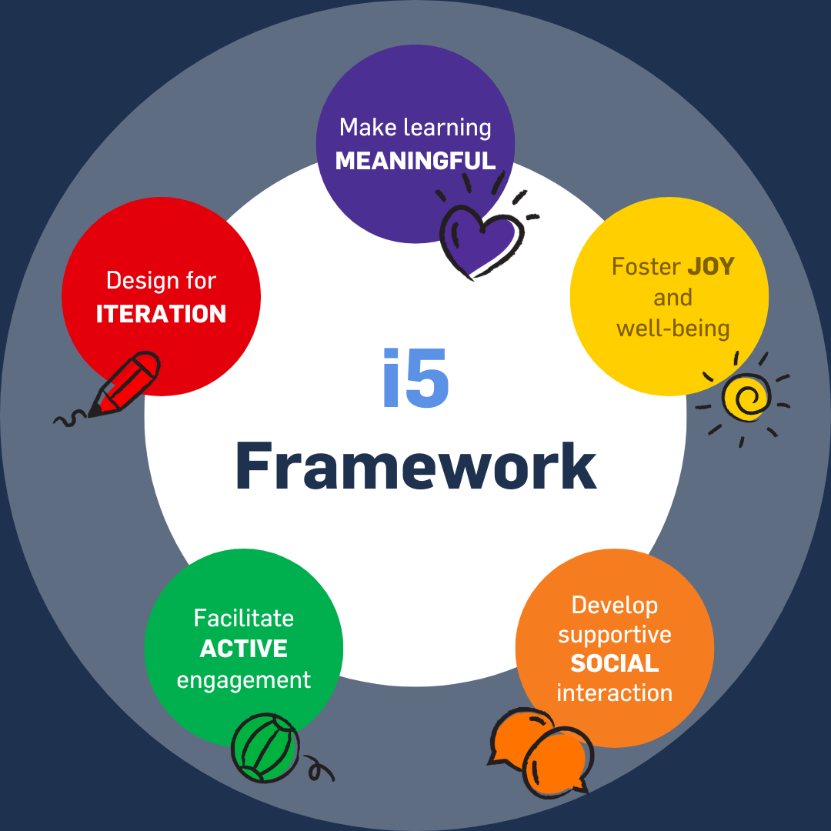
Aim of this PRME Games Project
To customise existing commercially successful card-based games to create sustainable and reusable pedagogical tools.
To produce ‘educational packs’ including copies of the game for group use in seminars, developing professionally printed card decks and teaching support resources.
  e.g. how to play the game, intended outcomes and suggested activities.
To incorporate PRME values into academic teaching activities creating an effective approach for learning about responsible leadership & sustainability.
To embrace the impactful five (i5) principles, creating fun and engaging ways for students to learn about the curriculum.

Slide 5
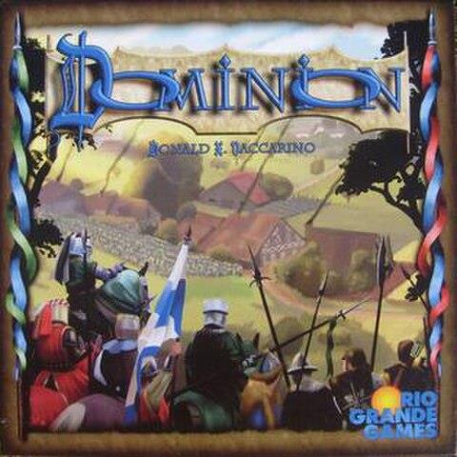
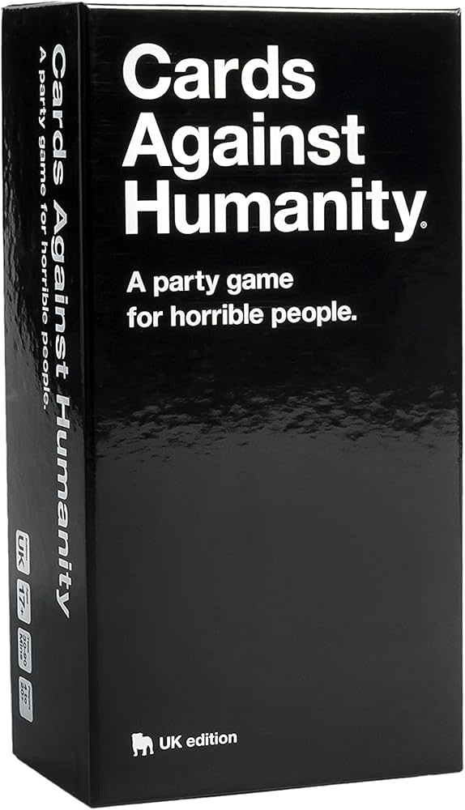

Project Game Outputs
1) 17 SDGs Memory Game
  Based on: Memory
  Type of game: Set Collection
2) PRME Pumps
  Based on: Top Trumps
  Type of game: Trick Taking
3) Cards for Sustainability
  Based on: Cards against Humanity
  Type of game: Party Game
4) Concord
  Based on: Dominion
  Type of game: Deck Builder

Slide 6
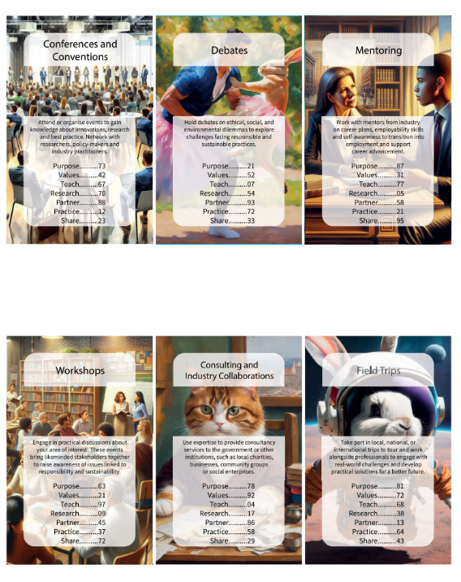
Educational Pack
Includes:
Print & Play copy of each game (PDFs)
  Game cards
  Instructions
Teaching Support Resources (these slides)
  Intended outcomes
  How to play the game
  Suggested activities*
*Educators are encouraged to adapt these to best suit student needs.

Slide 7
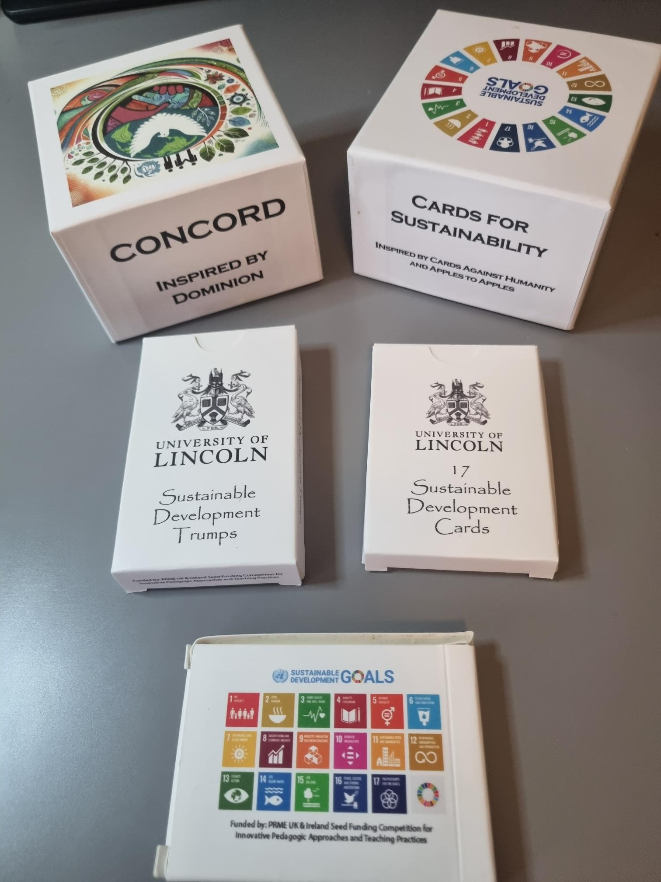
How to use this Educational Pack
This pack is designed to provide interactive activities to explore sustainability and responsible management in the classroom.
Print & Play: Ready-to-use copies of the card games are available for immediate classroom engagement.
Accessible Teaching Tools: These games offer a simple yet effective way to spark conversations about sustainability and responsibility.
Activity Development: The materials in this pack provide structured learning experiences that incorporate the game materials and enhance understanding of key concepts.
Flexible Adaptation: Educators are encouraged to tailor these resources to best fit their students’ needs and learning environment.
PRME Pumps

Slide 8
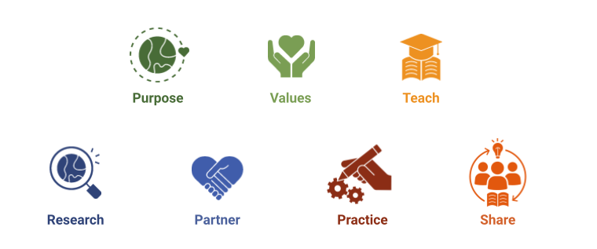
PRME: Principles for Responsible Management Education
The Principles for Responsible Management Education (PRME) is an UN-backed initiative.
It aims to inspire and lead global responsible management education, research, and thinking.
PRME transforms business education by adding sustainability and social responsibility into its core teaching.
Seven Principles:

Slide 9
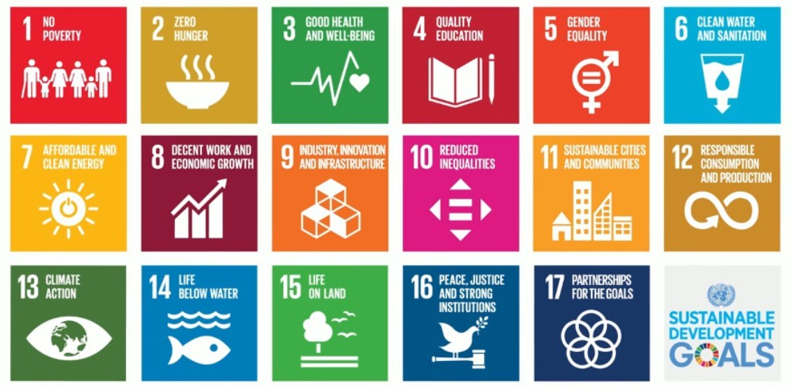
SDGs: Sustainable Development Goals
The Sustainable Development Goals (SDGs) are a collection of 17 interlinked global goals designed to be a "blueprint to achieve a better and more sustainable future for all."
Adopted by all United Nations Member States in 2015 as part of the 2030 Agenda for Sustainable Development, they address the global challenges we face.​

Slide 10
PRME/SDG Useful Resources
The 17 SDGs
https://sdgs.un.org/goals
The 170 Actions Series
https://www.ungeneva.org/en/engage/action
Integrating SDGs into Teaching
https://www.unprme.org/sdg-integrations/
I5 Playbook
https://www.i5playbook.org/

Slide 11
Games Summary
Game | Learning Objective | Complexity | # of Players | Duration
SDG Memory Game | Introduce the 17 SDGs | Low | 2-5 | 10m
PRME Pumps | Familiarize students with the seven PRME principles | Low | 2-6 | 15m-30m
Cards for Sustainability | Highlight individual actions for achieving the 17 SDGs | Medium | 2-6 | 15m-30m
Concord | Encourage collaborative decision-making using the seven PRME principles to achieve the 17 SDGs | High | 2-5 | 45m+

Slide 12

1. SDG Memory Game
Play this game with students who have little familiarity with the individual Sustainable Development Goals.
Acts as a method for developing awareness of different categories of sustainability which can be expanded on during class activities and discussions.
Skills involved: decision making, logical reasoning, communication, competitiveness awareness, conceptual linking.

Slide 13
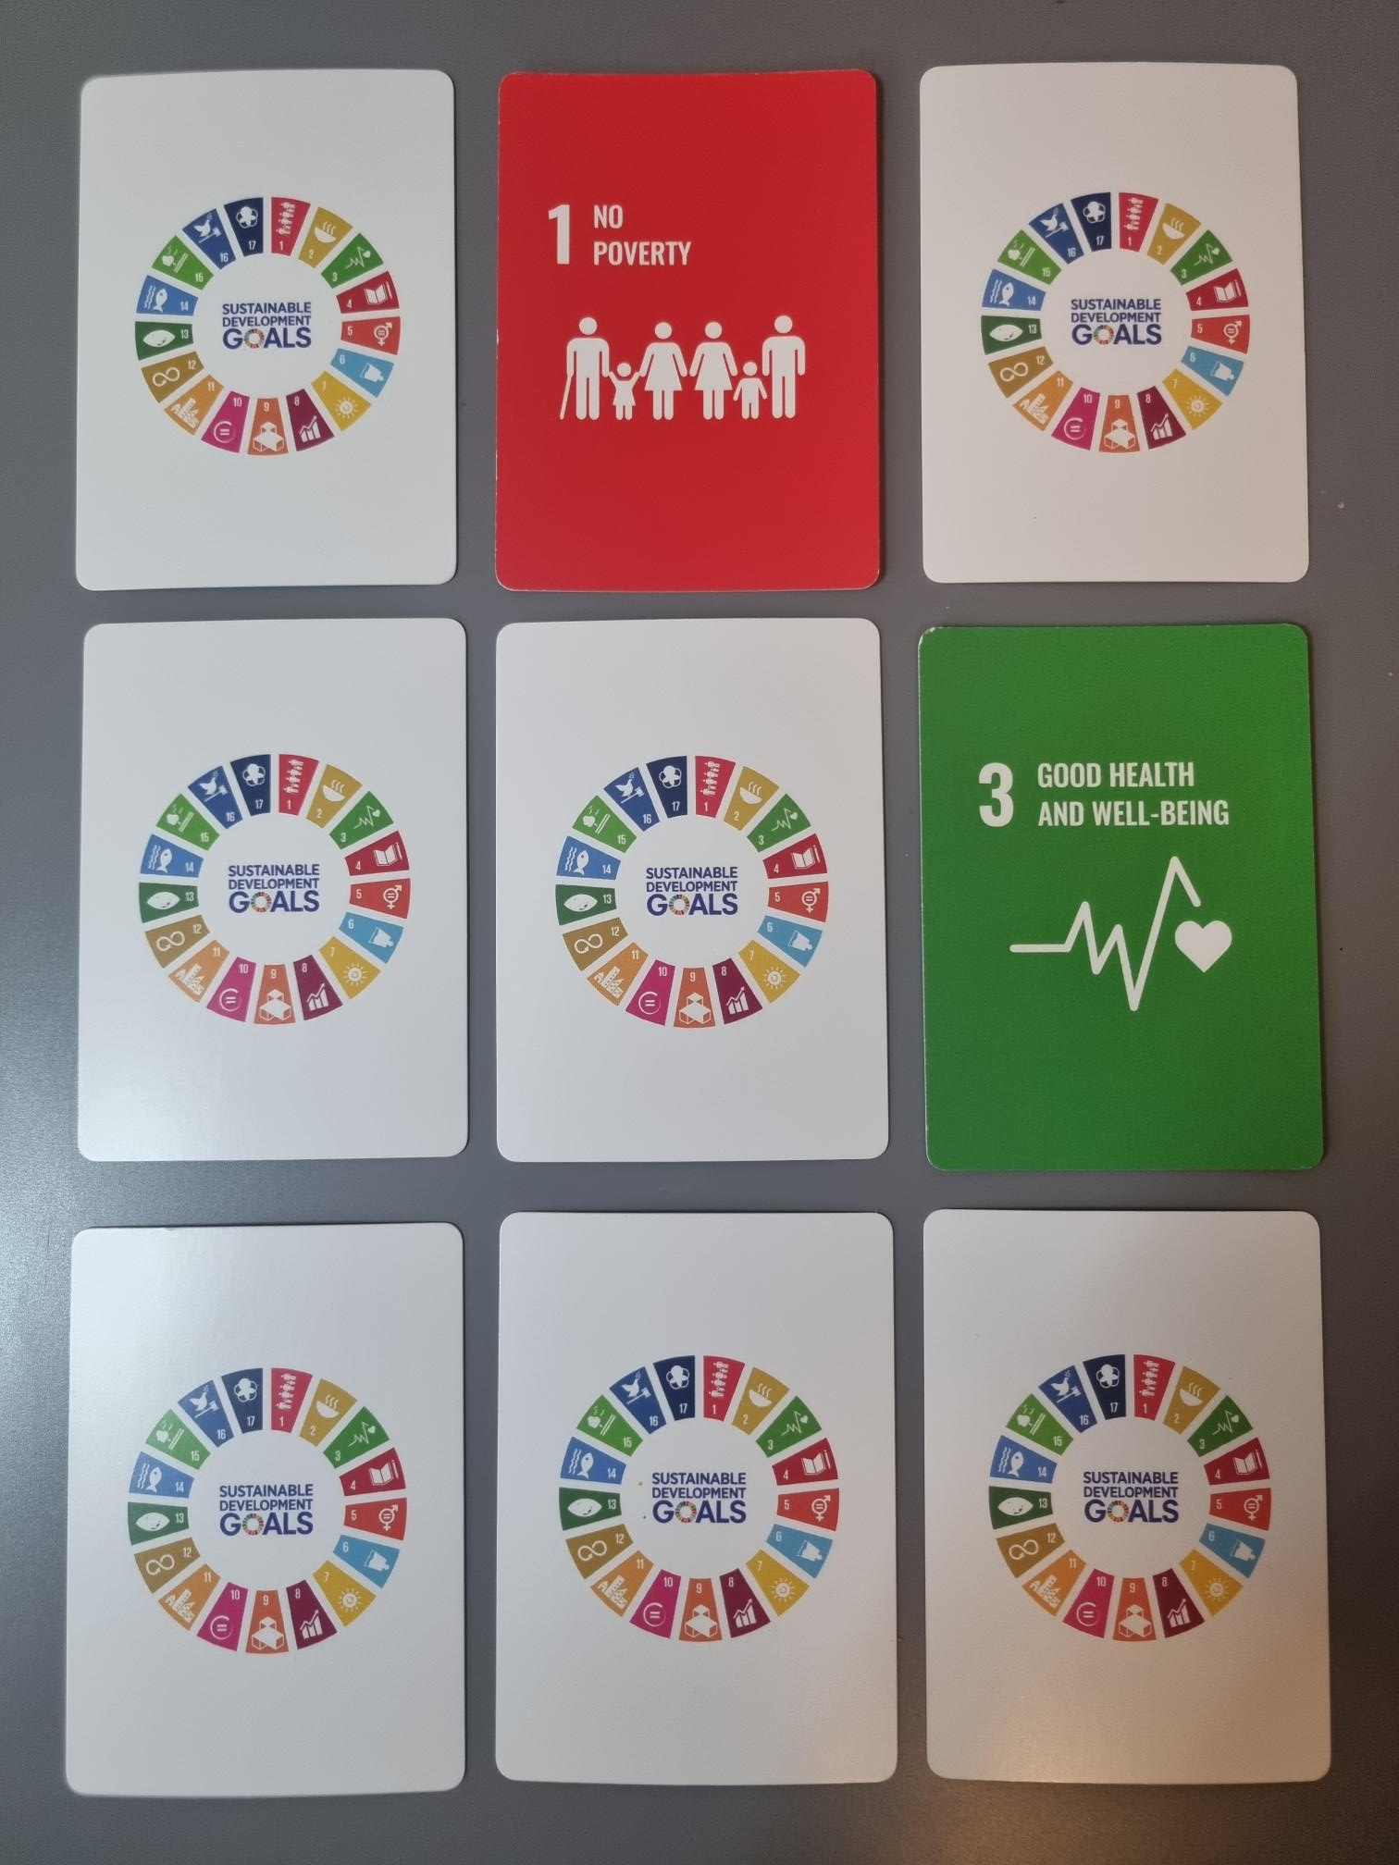
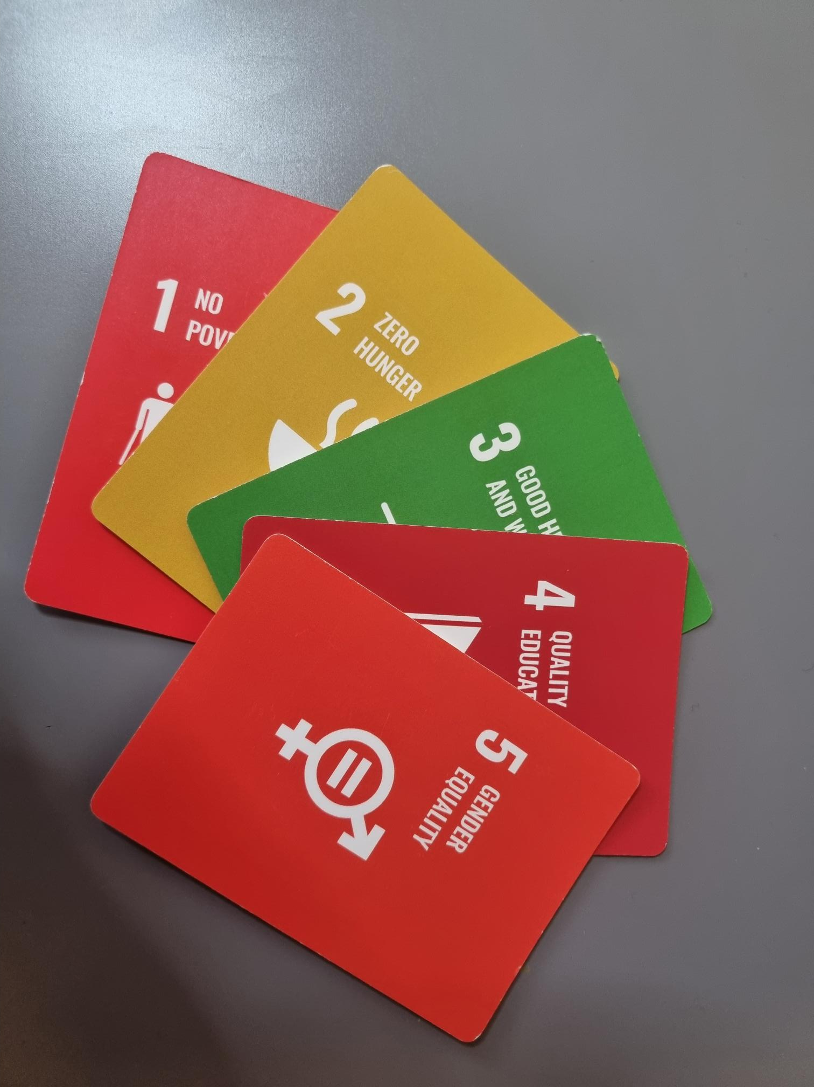
Examples: 17 SDGs Memory Game

Slide 14
Setup & Gameplay
Setup: Shuffled together two packs of Sustainable Development Goal (SDG) cards. Lay the cards faced down in a grid (start with a 5x5 and add extra cards as you like).
Objective: To match pairs of identical cards.
Gameplay:
  Players take turns.
  On your turn, flip over two tiles.
  If the tiles match, keep them and take another turn.
  If they don’t match, flip them back over and the next player takes a turn.
Winning: The game ends when all pairs are matched. The player with the most pairs wins.

Slide 15
Activity: Group Discussion
🧠 Challenge: Identify the most innovative real-world activities or initiatives linked to one or more SDGs.
⏳Rapid-Fire Round: Present ideas in under 60 seconds to keep discussions dynamic and focused.
🔎 Deeper Analysis: Discuss the impact of these initiatives - how do they contribute to achieving the SDGs?
💡Who’s Involved? Explore the role of businesses, governments, or individuals in driving these activities forward.

Slide 16
Activity: Consulting Challenge
👨‍💼 Your Role: Act as consultants advising a company on how to address challenges related to a chosen Sustainable Development Goal (SDG).
💡 Propose Solutions: Develop specific strategies that align with business models or policies to advance progress on the selected SDG.
🔎 Deep Dive Analysis: Research the SDG's specific goals, current progress, and successful initiatives to strengthen your proposal.
💬 Feedback & Refinement: Engage in a peer critique round—review each group’s ideas, offer constructive feedback, and refine solutions together.

Slide 17
Activity: The 5P Framework
🌍 The Challenge: Group SDGs into the 5Ps - People, Planet, Prosperity, Peace, and Partnership - and justify your choices.
❓ Question the Categorization: Are any SDGs cross-cutting? Could they belong in multiple categories? Challenge and defend your reasoning.
📌 Real-World Case Study: Examine how businesses or organizations integrate SDGs into their practices - what strategies do they use?
💡 Critical Thinking & Discussion: Engage in debate, question assumptions, and refine your understanding of how SDGs are structured.

Slide 18
5P’s Framework
This is a suggested grouping, however, several of the SDGs may fall under more than one category.
People | Prosperity | Planet | Peace | Partnership
1. No Poverty 2. Zero Hunger 3. Good Health and Wellbeing 4. Quality Education 5. Gender Equality 6. Clean Water and Sanitation | 7. Affordable and Clean Energy 8. Decent Work and Economic Growth 9. Industry, Innovation and Infrastructure 10. Reduced Inequalities 11. Sustainable Cities and Communities | 12. Responsible consumption and production 13. Climate Action 14. Life Below Water 15. Life on Land | 16. Peace, Justice and Strong Institutions | 17. Partnerships for the Goals.

Slide 19
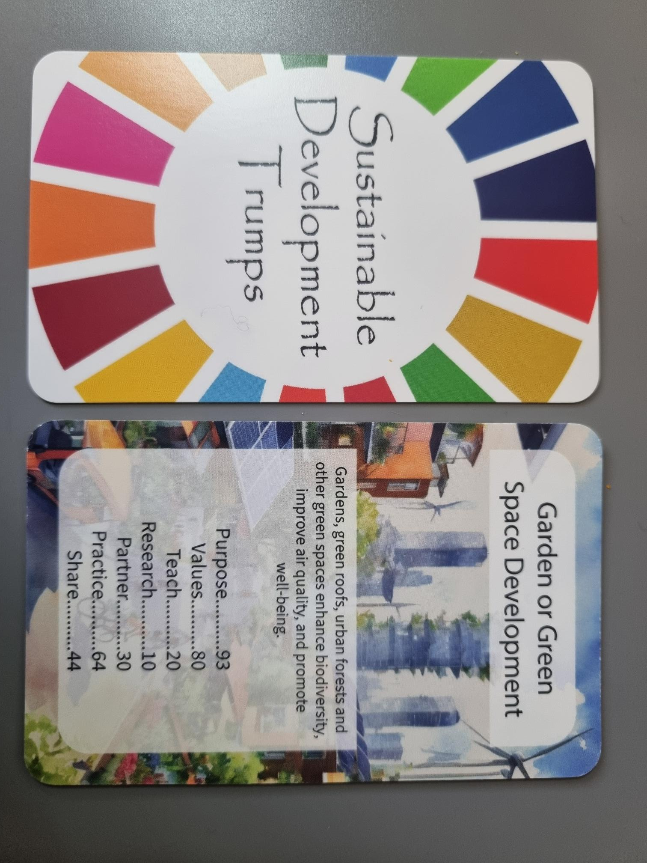
2. PRME Pumps
Use to familiarize students with the seven PRME principles.
Creates exposure to actions for sustainable development
Skills involved: comparative analysis, tactical planning, risk assessment, decision-making.

Slide 20
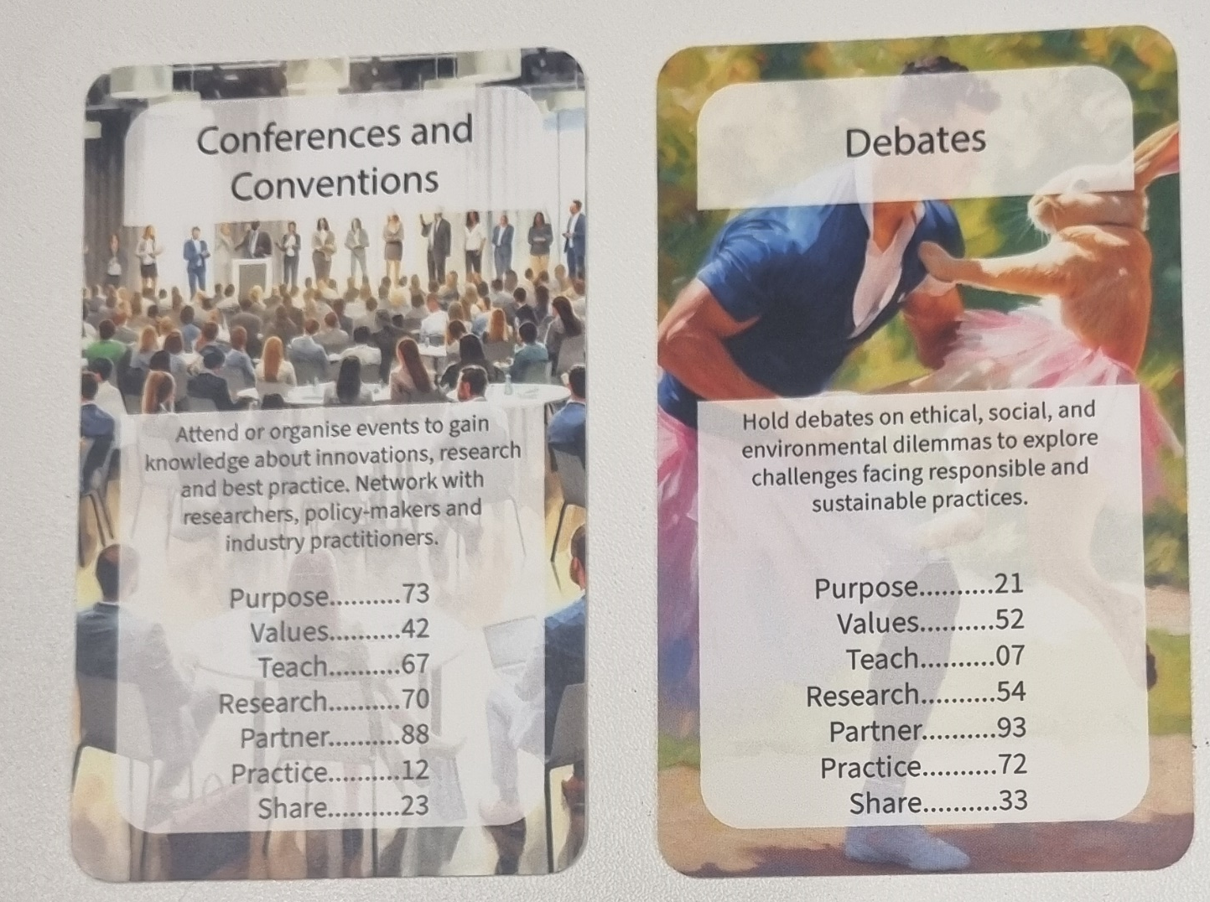

Examples: PRME Pumps

Slide 21
Setup & Gameplay
Deal Cards: Shuffle and deal equally to all players.
Top Card Only: Hold your deck face up; only the top card is visible.
Start Play: Player left of the dealer picks a stat from their top card (e.g., Values 42). Others read the same stat from their top card.
Compare Stats: Highest value wins. Winner takes player’s compared cards (except their own) and places them at the bottom of their deck.
Next Turn: Winner chooses the next stat from the winning card. If there's a tie, place tied cards in the middle and compare the same stat from the next card. Winner takes all.
Winning: The player who collects all the cards wins.
Optional Fast Finish – “Discard Rule” Losing cards are removed from play. Last player with cards wins.

Slide 22
Activity: The Strongest Card
🏆 Selection & Justification: Each group chooses the strongest card based on the seven PRME principles, impact, feasibility, and relevance to sustainability.
🎙️ Presentation & Discussion: Groups justify their selection with a short explanation, considering why this action matters and how effectively it contributes to SDGs.
🔄 Peer Challenge: Other teams can question, challenge, or suggest alternatives, prompting deeper discussion on barriers to implementation and real-world applications.
✅ Voting & Reflection: Students vote on the most convincing choice, reflecting on why certain actions stand out and how context influences their impact

Slide 23
Activity: Business Strategy Workshop
📝 Select an SDG Action: Choose a specific SDG-related action or PRME principle from the cards.
🏢 Business Focus: Identify a company that is actively implementing this action in its strategy.
🎭 Role-Playing as Advisors: Step into the role of sustainability consultants advising the company on how to enhance its approach.
💡 Strategy & Recommendations: Present key actions the company is taking and propose additional steps to improve impact.

Slide 24
Activity: Categorizing Cards by SDG
🏷️ Categorize the Cards: Work in groups to assign each card to the most relevant SDG, based on its action and description.
🔍 Cross-Categorization Debate: Identify cards that could belong to multiple SDGs, then discuss and justify their placement.
🌍 Real-World Connections: Select one action card and identify a company implementing a similar activity, how does it support their sustainability efforts?
🚧 Barriers & Solutions: What challenges exist in implementing the selected activity, and what strategies—such as policies, partnerships, or innovations—can help overcome them?

Slide 25
Activity: Create Your Own Card
🎯 Define an Action: Create a realistic action that could contribute to achieving this SDG. Either design your own or use inspiration 170 actions documents.
⚖️ Impact Level: Decide whether the action is designed for companies, governments, or individuals, and justify its relevance.
📝 Write a Short Description: Provide a brief explanation of how the action supports sustainability.
🔢 Assign Attributes: Determine numerical values for each of the seven PRME principles which best represent your activity (see template on next slide).

Slide 26
[Activity Template] SDG Action Card
Title
[Image]
Description
Purpose | X
Values | X
Teach | X
Research | X
Partner | X
Practice | X
Share | X
This template can be copied into Microsoft Word and completed either in print or electronically.
Images can be generated by AI by providing a mixture of prompt words.
→ For example: Padlet has a feature called ‘I can’t draw’ which can be used to generate images

Slide 27
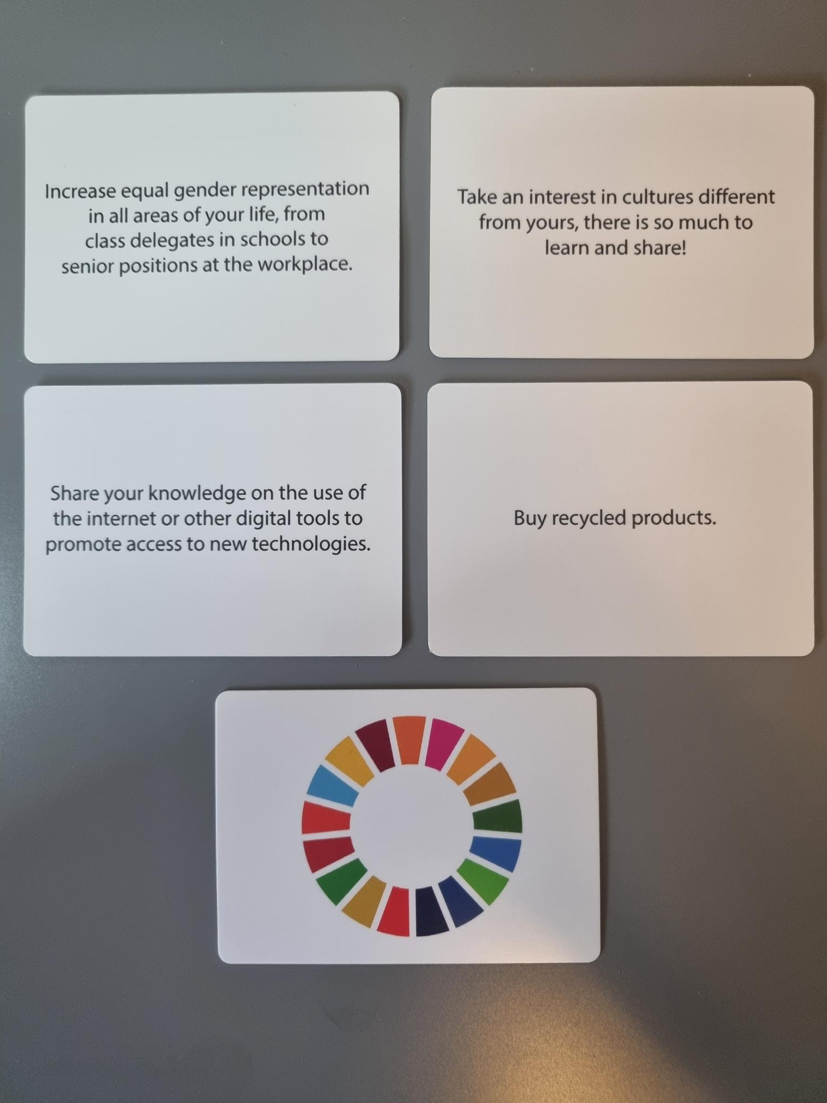
3. Cards For Sustainability Game
A party-style game inspired by Cards Against Humanity.
Encourages critical discussion by matching sustainability practices to SDGs.
Highlights individual actions for achieving the 17 SDGs.
Skills involved: quick thinking, creativity, justification, contextual awareness.

Slide 28
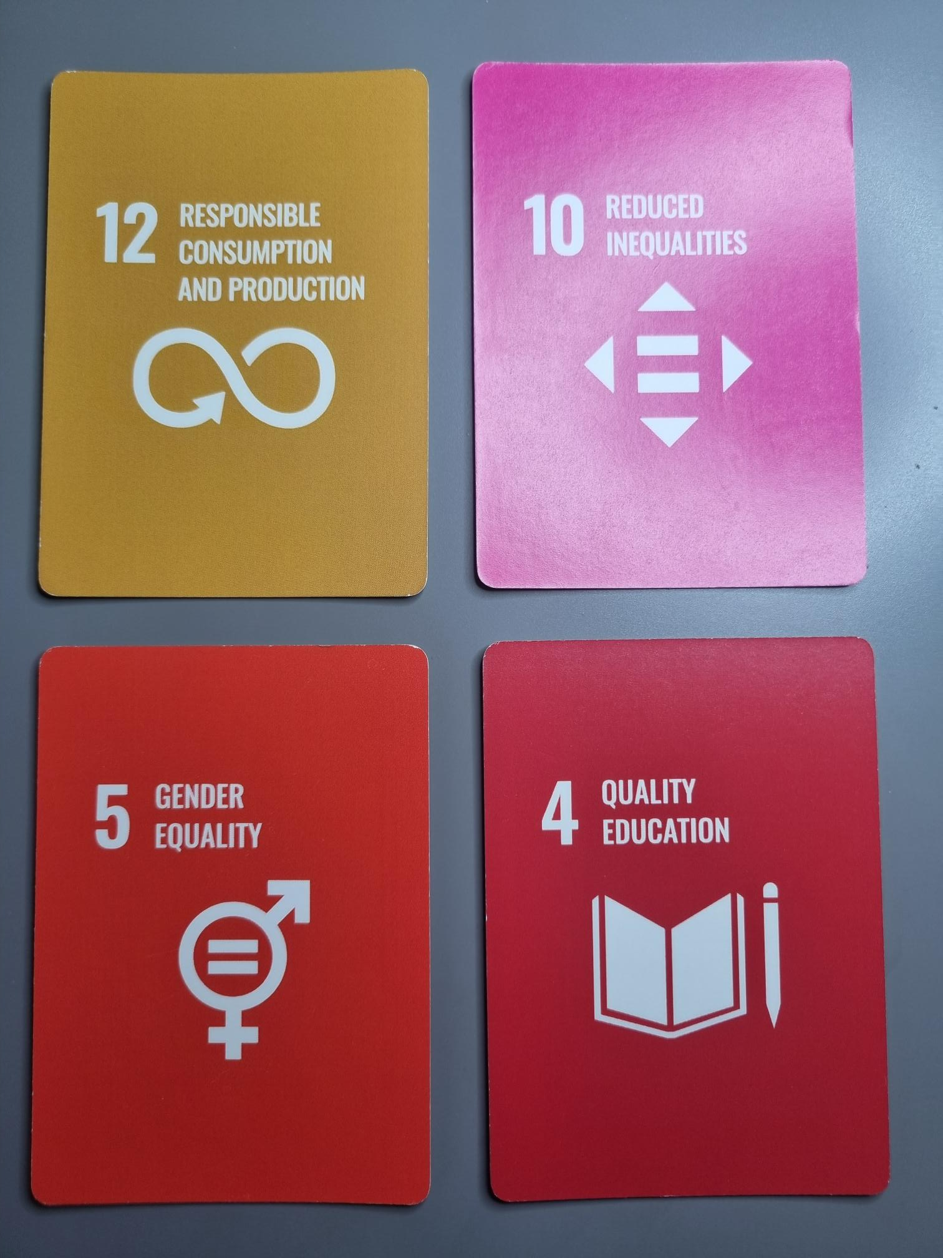
Examples: Cards for Sustainability

Slide 29
Set up & Gameplay
Each person draws 10 action cards.
The person who most recently picked up litter begins as the Leader by playing one of the 17 Sustainable Development Goal (SDG) cards and reads out the title.
Everyone selects an action card which they think best applies to the active SDG card and passes it to the Leader.
All answers are shuffled & the combinations read out by the Leader.
The Leader picks the card they feel is most relevant, and the person who submitted it gets the card. All other cards are discarded.
After the round, a new player becomes the Leader & everyone draws a new action card.
The first player with 5 cards, wins!

Slide 30
Variations
This game consists of 204 actions related to sustainable development – 12 actions directly associated with each of the 17 SDG – offering multiple ways to engage with the cards. Gameplay can be adapted based on learning objectives:
SDG Card Selection (Single SDG):
  Players choose a specific SDG to focus on.
  The goal is to match the 12 cards which align* with the chosen SDG.
  Discussion follows, evaluating how each action contributes to the goal and its real-world application.
Match Actions & Goals (Multiple SDGs):
  All 204 cards are shared between the players.
  The goal is to align* each action card to the relevant SDGs based on its description.
  Players collaborate, debate placements and explore interconnections between different goals
*See suggested answers in later slides.

Slide 31
Activity: Future Vision
🔮 Imagine 2050: Consider how the world might look if key SDG actions were widely implemented.
🌍 Identify Transformative Actions: Which actions would have the greatest impact on society, business, and the environment?
🔄 Challenges & Adaptations: What obstacles might arise? How would businesses, governments, and individuals need to adapt?
📢 Present Your Vision: Share a compelling future scenario, describing the role sustainability plays in shaping industries, policies, and everyday life.

Slide 32
Activity: Impact Debate
🎯 Choose an Action Card: Each student selects an SDG action they believe is high-impact or particularly important.
🗣️ Defend Your Choice: Present arguments on why this action should be prioritized, considering feasibility, effectiveness, and urgency.
🔄 Challenge & Counterarguments: Others question or challenge the choice, discussing possible limitations or alternative approaches.
✅ Consensus & Reflection: As a group, evaluate which actions have the strongest real-world impact, identifying key factors that drive success.

Slide 33
Activity: Personal Action Challenge
🔍 Choose an SDG Action: Each student selects an action card they find interesting or meaningful.
🤔 Self-Reflection: They consider how they could personally implement this action in their daily life, studies, or future career.
🚧 Barriers & Motivators: What obstacles might prevent them from taking action? What would increase the likelihood of them doing it?
🚀 Commitment & Strategy: Each student identifies small, realistic steps they could take to make this action a reality.

Slide 34
Definitive Card List (SDG 1)
No Poverty
Action Description
Buy fair-trade products to support the sustainable trade system, meaning employees are rewarded fairly for their work
Buy clothing or other products from stores that donate a portion of their money to charities
Clean out your pantry Fill a box with non-perishable foods and donate it to a foodbank
Volunteer in homeless shelters Your time can be more valuable than money
Donate to sustainable development projects
Donate old clothes or household items to those in need
Participate in car sharing
Familiarise yourself with the NGOs working towards the eradiation of poverty and donate to them, if you can
Adopt good budgeting practices and share them with others to teach people how to be financially responsible
If you can, donate to charities seeking to reduce poverty
Learn about the impact that a sustainable lifestyle can have on reducing poverty
Try to avoid over consuming, buy only what is necessary

Slide 35
Definitive Card List (SDG 2)
Zero Hunger
Action Description
Support food assistance progams They provide over 20 times more food than food banks, food pantries and soup kitchens
Many emergency food providers need specialized skills such as accounting, social media or writing skills Volunteer your expertise once a week
Support local farmers by buying your food at farmer's markets
Use a food saving app to encourage no wastage
Minimise red meat & dairy consumption It contributes greatly to deforestation, which displaces and forcefully evicts many species from their habitats
Eat seasonal fruit and vegetables
Buy organic food
Check the ingredients labels on your food because some ingredients are more harmful for the environment than others
Provide non-perishable food to shelters, schools or associations in need
Support local food banks that distribute food to those who have difficulty purchasing enough
Share your meals' with children in need through apps such as World Food Programme ShareTheMeal
Strive towards zero food waste Every day, about 25,000 people die of hunger

Slide 36
Definitive Card List (SDG 3)
Good Health and Wellbeing
Action Description
Don't smoke
Eat a healthy diet and drink lots of water
Never stop learning, so learn a new skill & read a lot
Make time for you and your friends
Walk or use your bicycle instead of a car, because it is better for your health and reduces congestion within a city
Switch off your electronic devices to lower energy consumption and enjoy the real world
Go "plogging" (Jogging whilst picking up litter)
Become aware of existing inequalities generated by health conditions
Stand up for fairer conditions and payments for nursing staff
Promote and participate in urban sports training sessions, free and accessible to everyone
Share your experiences of good health habits to inspire oters who may not have access or knowledge of such practices
Unhealthy highly processed foods tend to be prominent amongst disadvantaged communities, due to their lower prices. Spread the word about a more equitable access to a health diet worldwide

Slide 37
Definitive Card List (SDG 4)
Quality Education
Action Description
Educate your kids about the power of education, as many don't see the tangible benefits
Show films or TV shows that are educational as well as entertaining for children
Take education outside the school and keep it fun. Travel. Take kids on day trips to the planetarium or museums
Share your skills with the ones who need them.
Educate yourself on how to recycle properly
Share your environmnetal tips with friends and family
Share ideas for sustainable behavioural change to friends and family who don't know where to start
To bridge the education gap, promote access to education for young girls and women
To combat educational inequalities, ensure that children have access to a good education and school materials such as pens and books
Students with learning difficulties are too often left behind. Involve tehm in study group sessions and be sure to mobilise collective learning environments
Stand up against bullying in your learning environment
Volunteer to be a teaching assistant in communities that lack educational resources

Slide 38
Definitive Card List (SDG 5)
Gender Equality
Action Description
Increase gender representation in areas aof leadership in the workplace
Practice and demonstrate to children equal decision-making processes at home
Make flexibility and work-life balance a part of the company's culture
Be aware of gender parit when supporting sustainable development projects
Support sustainable, female-owned businesses
Gender equality starts at home. Involved all members of the family in eco-household activities such as recycling, independently of their gender
Advocate for increased gender representation among policy makers
Sign up for training on gender equality in the workplace
Increase equal gender representation in all areas of your life, from class delegates in schools to senior positions at the workplace
Be open to using gender-neutral language, such as gender-neutral pronouns or job-titles
Campaign for equal pay between men and women
Read books to children that dismantle gender sterotypes in order to educate them about existing gender inequalities and how to tackle them

Slide 39
Definitive Card List (SDG 6)
Clean Water and Sanitation
Read a book on water. It will increase your understanding of the impact water has in societies, economies and our planet
Conserve, conserve, conserve. When ice-cubes are left over from a drink, don't throw them away. Put them into plants
Fix leaks at home. A leaky faucet can waste more than 11,000 litres per year.
Turn off the tap when brushing your teeth and while soaping in the shower
Use a reusable water bottle to avoid plastic waste
Use natural detergents to clean your house
Switch your plastic toothbrush for a bamboo one.
Educate yourself on how chemical products can contaminate water resources
Wash your hands frequently to mitigate the spread of diseases, infections and illness, which often impact the poorest populations more gravely
More than 200 million people worldwide are expected to be internall displaced by 2050 due to water scarcity and water conflicts. Get familiar with hyrodiplomacy issues and raise awarenes among your community on the social implications of water scarcity
Educate children about water waste to ensure water-conserving habits from a young age
Avoid buying products from companies pouring chemicals into water resources
Read a book on water. It will increase your understanding of the impact water has in societies, economies and our planet

Slide 40
Definitive Card List (SDG 7)
Affordable and Clean Energy
Action Description
Cover cooking pans with a lid. It reduces the amount of energy required to boil water by 75%
Turn off electronic equipment, such as TVs and computers
Turn lights off in rooms that aren't being used. When you switch off lights even for a few seconds, it saves more energy than it takes for the light to start up, regardless of the bulb type.
Use energy-efficient lightbulbs and set your household appliances on low-energy settings.
Only fill the kettle to the amount of water needed.
Consider switching to a green energy provider
Inform yourself about where your electricity comes from and how it is produced
Install a solar panel for your home
Be aware of the energy your home consumes
1.2 billion people live without electricity and nearly 40% of the world's population do not have access to cooking fuels. Advocate for more policy discussions around "energy poverty" to reduce the consumption and support NGOs striving to reduce this number
If you can, commit to non-CO2 emitting ways of transportation. Can you walk or bike to work?
Consumer from businesses that introduce projects towards the transition from fossil fuel to zero carbon use and production

Slide 41
Definitive Card List (SDG 8)
Decent Work and Economic Growth
Action Description
Provide stability. Empower young professionals to grow into their positions
Provide incentives for hard work. People respond to a reward system
Ensure safe working conditions
Make people aware of the fact that climate change will have economic consequences
Buy products from companies with a lower carbon footprint
Advocate for corporate social responsibility
Consume fair-trade product, which ensure more ethical and equal standards of production and distribution to help develoing countries.
Learn about initiatives that promote inclusive economic growth
Discourage the requirement of indicating name, origin and photo in professional work applications, to ensure recruitment is unbiased and exclusively based on qualities
Promote multicultural dialogue in your workspace
Provide opportunities for people to retrain professionally when their previous job becomes obsolete. Technical innovation leaves a significant number of people behind
Respect and advocate for fair maternity and paternity leave conditions

Slide 42
Definitive Card List (SDG 9)
Industry, Innovation and Infrastructure
Action Description
Encourage sustainable infrastructure with efficient resources and environmentally friendly technologies
Keep up to date with the latest technologies and innovation
Don't throw away, give away. Upgrading our electronic gadgets is inevitable, but often our gadgets are still in good working condition. Pass on your old working devices or recycle as certain parts can be recovered.
Support green startups in your city
Assess your carbon footprint
Think entrepreneurially, your next idea could help. Believe in it.
In order to improve your city's air quality, turn empty rooftops into green spaces
Support university digital access to co-operation for the 3.6 billion people who remain off-line
Consider backing students' projects and ideas that contribut eto sustainable development. Innovation starts with youth
Be informed about sustainable finance and try adopting it into your daily life
Not all products are ethically produced and may feed into growing global inequalities. Inform yourself about the origins of the products you buy
Share your knowledge on the use of the internet or other digital tools to promote access to new technologies

Slide 43
Definitive Card List (SDG 10)
Reduced Inequalities
Action Description
Encourage children to make friends with kids from different cultures
Learn to respect all kinds of people who may do things differently than you
Travel the world to learn about different cultures
Read storybooks to children that describe all cultures
Buy locally made products
Help food banks and homeless centres to offer nutritious and sustainable food
Learn about and advocate against climate injustices
Take an interest in cultures different from yours, there is so much to learn and share!
Be cautious of your daily language to avoid unconscious discrimination of people
Publicly denounce and report any discriminatory act, such as bullying, racial persecution, gender-based or sexual harassment, that you witness at school, work or within your group of friends and family
Respect and embrace differennces, regardless of race, ethnicity, gender and social status
Put yourself in someone else's shoes and be kind to others!

Slide 44
Definitive Card List (SDG 11)
Sustainable Cities and Comunities
Action Description
Start a car-pooling system online, internally in the office, or in areas that don't have access to reliable public transport
Advocate and support the development of sport and recreational spaces. They help build stronger, healthier, happier and safer communtiies
Use public transport, city bikes and other modes of environmentally friendly transport
Provide reduced fees on public transport in cities that face the challenge of congestion
Learn about the cultural and natural heritage of your area. Visit heritage sites and post about these in a positive light.
Advocate for more and safer bike lanes
Support the elimination of single-use plastics in your community
Organise or participate in flea markets to give old things a new life
Participate in social and environmental justice workshops and conferences
Engage in local politics and advocate for equality in your city council
Grow plants in the streets and outside your building
Reduce your energy consumption

Slide 45
Definitive Card List (SDG 12)
Responsible Consumption and Production
Action Description
Donate clothes or other items you are not using
Buy fruit that is in funny shapes and overripe, and make smoothies out of them.
Keep showers short. Don't fill the bath to the top. Excessive use of water contributes to global water stress
Buy sustainable products including electronics, toys, shampoo or seafood and organic groceries
Eat local. And support fair trade associations that support and promote businesses committed to the principles of fair trade
Do a cold wash. Warm water uses more energy
Reduce, Reuse and Recycle!
Buy products made from reused or recycled materials
Buy organic cotton and other more earth friendly materials
Purchase clothing from brands that engage in responsible modes of production and support "slow fashion"
Consume less! Sustainble consumption and production is about doing more and better with less. Overconsumption causes resources to be unsustainably extracted, mainly affecting vulnerable communities
Encourage children to adopt recycling gestures from a young age (at school, at home, during outdoors activities, etc.)

Slide 46
Definitive Card List (SDG 13)
Climate Action
Action Description
Drive less. Walk, cycle, take public transport or car pool
Take re-usable bags to the store
Avoid driving in peak-hour traffic
Unplug TV's, computers and other electronics when not in use
Only buy what you need. 20-50% of the food we buy ends up in landfill
Donate to organisations involved in fighting climate change
Use your social media platforms to promote and raise awareness about the climate crisis
Dispel climate myths. Teach people what separates fact from fiction
Research. Engage. Innovate. We need climate action in all fields.
Understand why action is needed - read and learn about the climate crisis and the actions that you can take to make a change
Try being carbon neutral: it can improve public health, create jobs, benefit the climate, and costs less. It helps low-income households and poor communities, which are usually the most affected by climate change
Participate in the World Cleanup Day and invite your friends and family!

Slide 47
Definitive Card List (SDG 14)
Life Below Water
Action Description
Eat local sustainable food
Use fewer plastic products, which often ends up in oceans causing the death of animals
Watch educational documentaries to inform yourself about ocean activities
Only use the dishwasher and laundry machine when full
Conserve water! Turn off running taps and fix them if they leak
Pick up litter around you. Don't pollute the lakes, rivers and oceans.
Don't buy products containing microplastics
About 80% of all tourism takes place in coastal areas. Over 3 billion people depend on marine and costal biodiversity for their livelihood. Keep beaches and the marine environment clean
Urge companies to find alternatives to plastic to preserve oceans
More than 14 milion tonnes of microplastic are at the bottom of the ocean. Inform yourself about microplastics when buying cosmetics
Learn about and donate to organisation's fighting for ocean conservation
Buy reusable straws. It is good for the environment and to save marine wildlife

Slide 48
Definitive Card List (SDG 15)
Life on Land
Action Description
Eat seasonal produce. It tastes better, it is cheaper and it is environmentally friendly
Recycle used paper and go paperless where possible
When you shop make environmentally-friendly choices that are in favour of our planet
Eat less meat. The production and distribution of meat has a huge impact on greenhouse gas emissions
Make your own compost. It supports biodiversity, enriches the soil and reduces the need for chemical fertilisers
Buy recycled products
Practice responsible wildlife tourism
Pick up litter, leave only footprints
Leave plants and trees in their natural habitat
Support wildlife conervancies to avoid human/wildlife conflicts and ensure the safety of livestock
Plant & protect trees. They benefit all lives on earth and provide for the oxygen we breathe. They are also essential to some communities' environment as forests are home to 300 million people and 1.6 bilion people depend on them for their livelihoods.
Only print what you really need: over-consumption of paper has a real impact on deforestation which damages wildlife and people habitats

Slide 49
Definitive Card List (SDG 16)
Peace, Justice and Strong Institutions
Action Description
Make your voice heard and vote in your country's elections
Participate in your country's decision making processes in an informed manner
Stop violence against women. If you see it happening, report it.
Find value in different demographics, thoughts and beliefs for an inclusive society
Demonstrate a peaceful environment at home
If you work for an international organisation, work to de-escalate conflicts caused by climate change
Be a responsible steward of natural resources to avoid appropriation and exploitation.
Where possible, hold your government accountable to its climate targets
Discuss with people who are marginalised by climate injustices
Ensure an equal representation of staff in global and local decision-making positions (e.g. country, education, gender, etc.)
Engage in cultural, social and political activities of your local community
LGBTQ+ commuinties often battle with inequalities and discrimination. Work towards building a more inclusive world

Slide 50
Definitive Card List (SDG 17)
Partnerships for the Goals
Action Description
Teach kids about partnerships through sport
Collaborate with organisations that need funding in an area you feel strongly about
Collaborate with organisations in different countries who share the same goals you have
Be clear, specific and creative about your social goals
Practice teamwork at home. Share activities among all family members and outside the family
Bring sustainable values into your workplace
Encourage green innovation initiatives
Involve under represented groups in the environmental discussion
Highlight consumer behaviour as a powerful force behind demand
Be brave an start your own initiatives
Learn about the Sustainable Development goals and promote the agenda amongst your friends, family and social media accounts
Fake news and misinformation divide societies and exacerbate inequalities, hate and discriminatory practices. Verify your sources.

Slide 51

4. Concord Game
A cooperative deck-building game inspired by the competitive deck-builder Dominion.
Encourage collaborative decision-making using the seven PRME principles to achieve the 17 SDGs.
Players must balance self-interest and cooperation: do they improve their own deck, help others improve theirs, or work individually or together to achieve the SDGs?
Skills involved: strategic decision-making and planning, critical thinking, communication, team-work, resource management, adaptability, time management.

Slide 52
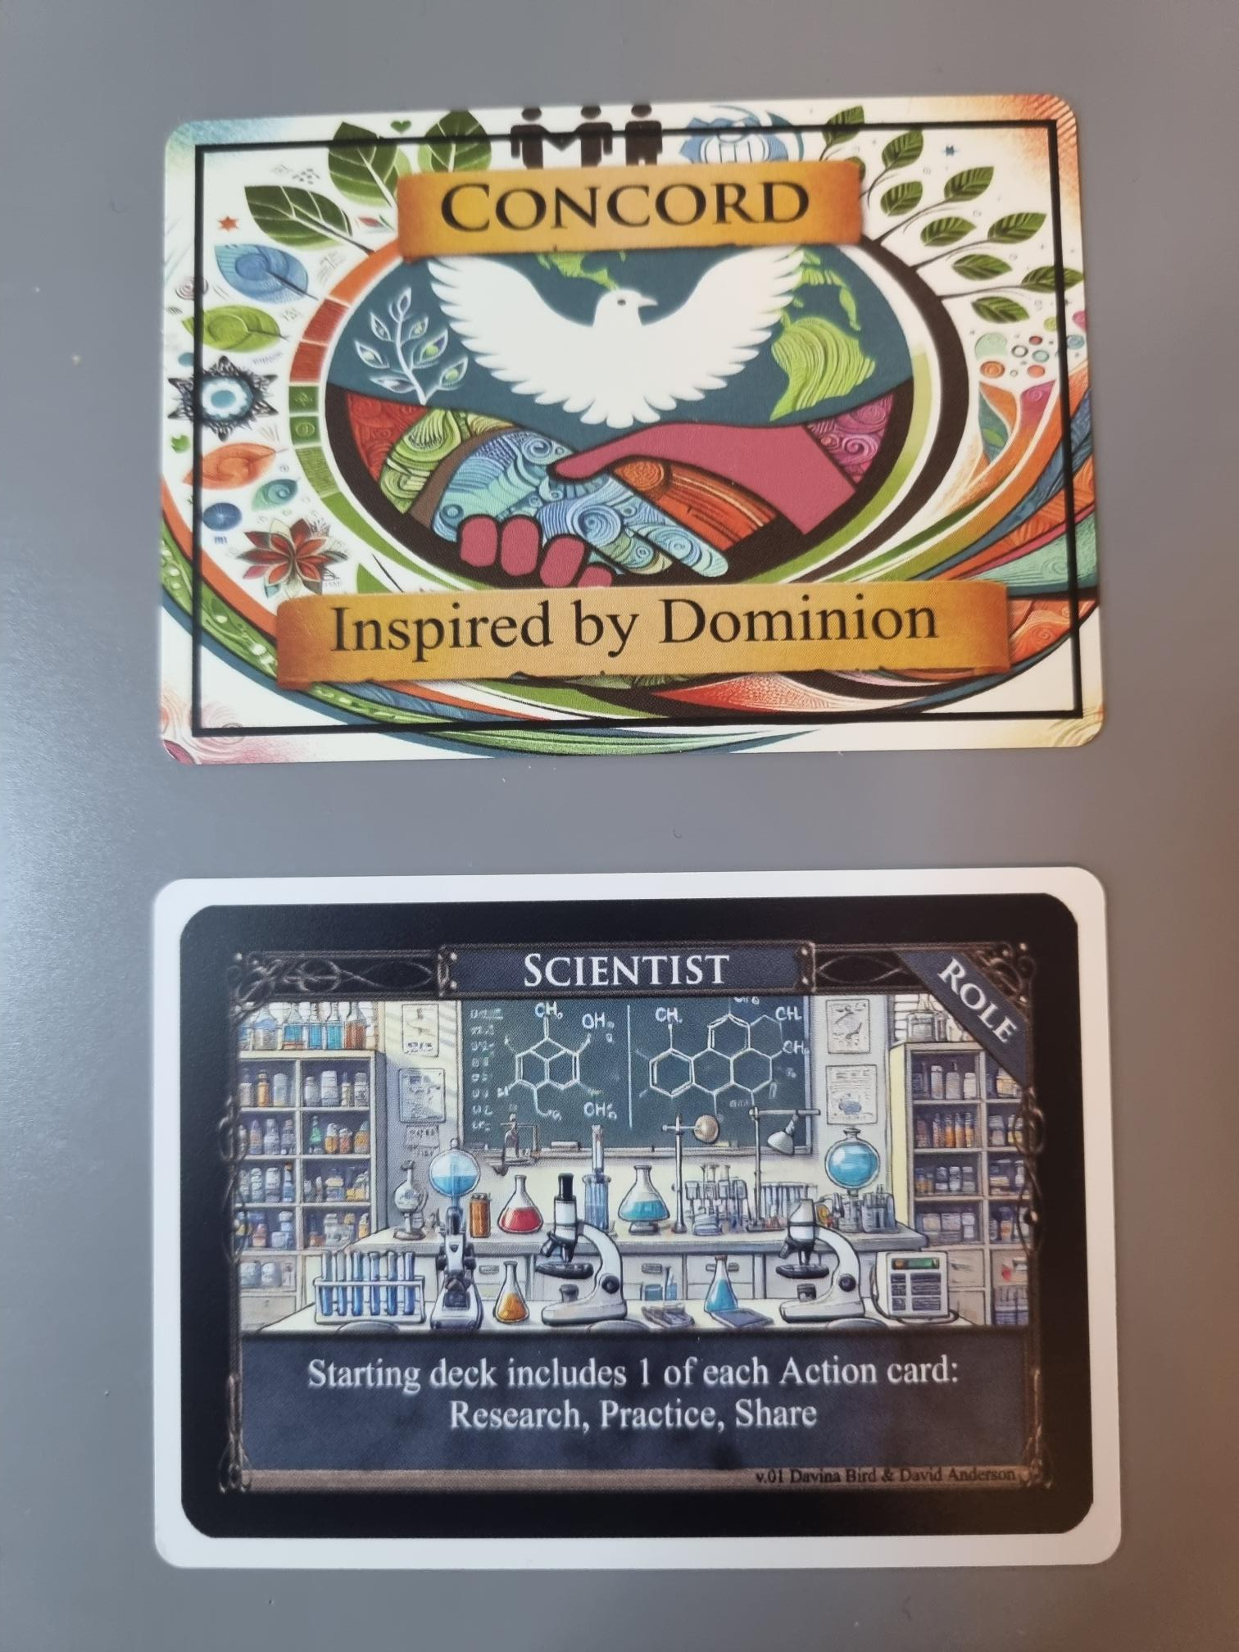
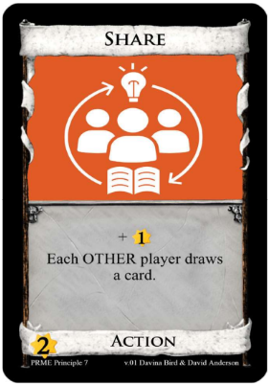
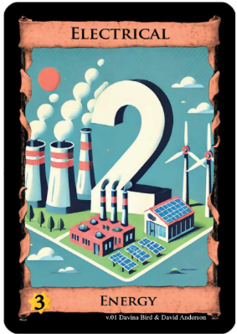
Examples: Concord

Slide 53
Setup & Gameplay
Estimated setup and instruction time: 15 minutes
Estimated playtime: 45 minutes
204 cards in the game
Card Types
  Energy: Thermal, Electrical, Atomic
  Actions: Different actions associated with the 7 PRME principles
  SDGs: Each of the 17 SDGs associated with one of the 5Ps (People, Prosperity, Planet, Peace, and Partnerships)
  Roles: Scientist, Academic, Politician, Entrepreneur, Activist
  Leader: Changes each round
  Time Counter: Limits the number of rounds depending on player count
See booklet instructions (in print and play PDF) for detailed rules.

Slide 54
Activity: Strategy & Impact
🃏 Most Used Actions: What action cards did you use the most and why? Discuss why certain cards were frequently played and explore their real-world applications for achieving SDGs.
🚫 Underutilized Actions: What action cards did you use the least and why? Identify overlooked cards and consider how these actions could be better leveraged in reality to advance SDGs.
🌍 SDG Feasibility & Challenges: Which SDG or set of SDGs do you think would be easiest to achieve? Debate which goals are most attainable given current global policies, technologies, and initiatives.
🚧 Barriers to Success: Which SDG or set of SDGs would be hardest to achieve? Why? Examine economic, political, and logistical barriers that make certain SDGs more difficult to implement.

Slide 55
Activity: PRME & SDG Recall
🔍 Listing: Work individually or in groups to list as many PRME actions and SDGs as possible without referencing the cards.
📊 Knowledge Comparison: Compare lists with peers to identify gaps in collective understanding and discuss patterns—are certain SDGs or actions remembered more frequently?
🧠 Reflective Discussion: Explore why some SDGs or actions stood out—was it due to familiarity, real-world relevance, or personal interest?
🤔 Implicit Bias Awareness: Consider how this exercise may reveal biases in our perception of sustainability—are certain goals overlooked or prioritized more than others?

Slide 56
Activity: Creative Redesign
🧠 Brainstorming & Redesign: Students work individually or in small groups to improve a weaker action card, making it more strategic in gameplay and more impactful in reality.
📢 Presentation & Justification: Each group presents their redesigned card, explaining how it enhances gameplay and its real-world sustainability applications.
✅ Class Voting & Selection: Optionally, conduct a class vote to determine the most effective redesign, considering both strategic improvements and real-world feasibility.
🎲 Testing & Implementation: If feasible, integrate the redesigned cards into a follow-up game session, allowing students to see their modifications in action.

Slide 57
Activity: Achievability Debate
🗣️ Structured Debate: Divide the class into two groups—one arguing for the feasibility of achieving all 17 SDGs within a set time frame, the other arguing against it.
🔍 Argument Development: Groups collaborate separately to build strong, evidence-based arguments, considering real-world challenges and opportunities.
⚖️ Debate & Discussion: Engage in a dynamic exchange of ideas, presenting counterarguments and critically analyzing opposing viewpoints.
📢 Outcome Reflection: Summarize key takeaways—did a consensus emerge, or do perspectives remain divided on the reality of achieving global sustainability goals?

Slide 58
Additional Support
These educational games were created by Davina Bird and David Anderson as part of a funded project supported by PRME UK & Ireland.
This resource is designed to enhance learning, spark discussion, and encourage interactive engagement with sustainability and responsible management principles.
For further guidance, collaboration, or questions about integrating these games into your curriculum, feel free to reach out:
  Davina Bird: dbird@lincoln.ac.uk
  David Anderson: danderson@lincoln.ac.uk
PRME Pumps

